Slide 1
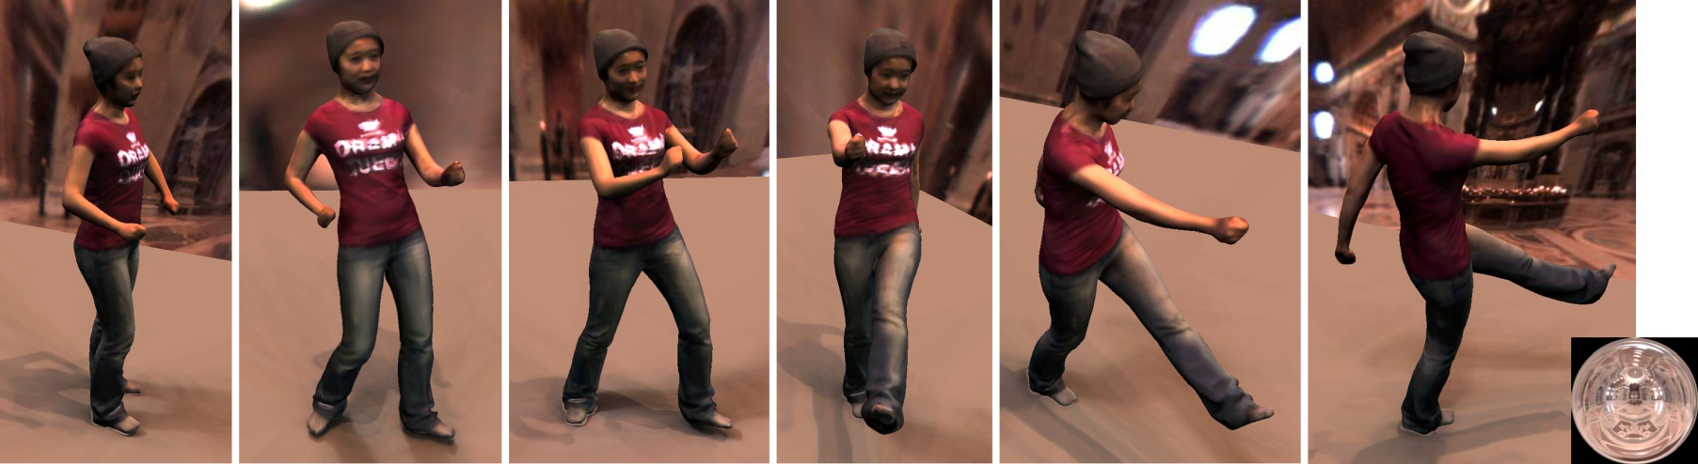



Capturing Relightable Human Performances under General Uncontrolled Illumination
Guannan Li¹, Chenglei Wu^{2,3}, Carsten Stoll², Yebin Liu¹, Kiran Varanasi², Qionghai Dai¹, Christian Theobalt²
Tsinghua University¹,
Max-Planck-Institut Informatik²,
Intel Visual Computing Institute³
Notes:
This work is about "Capturing Relightable Human Performances under General Uncontrolled Illumination".
The authors of this work are Guannan Li, Chenglei Wu, Carsten Stoll, Yebin Liu, Kiran Varanasi, Qionghai Dai, and Chrisitan Theobalt.
This is a joint work by Tsinghua University, MPI Informatik and Intel Visual Computing Institute.

Slide 2

Relightable Performance Capture
Notes:
Recently, we have shown the possibility to capture relightable human performance from multi-view video recorded under general uncontrolled and uncalibrated illumination.
The reconstructed performance can be realisticly rendered under new view-points in new incident lighting.
High frequency reflectance effects are faithfully captured, and even fine-scale detail looks realistic.

Slide 3
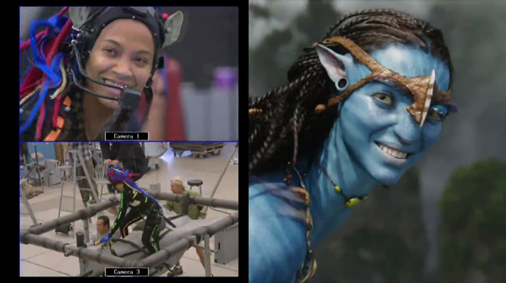
Background
Creating Human Performances Beyond the Recording Studio
In new lighting
Under new view-point
Notes:
In movie and game industry, capturing real performances of human actors in the studio, and then reproducing them in virtual environment, like <click> new incident lighting and new view-point, has become more and more important.

Slide 4
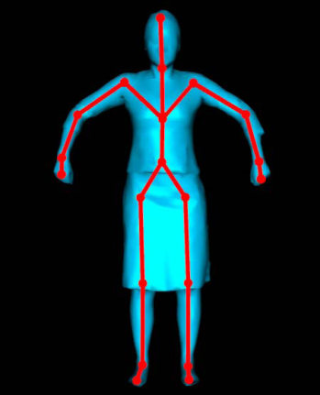

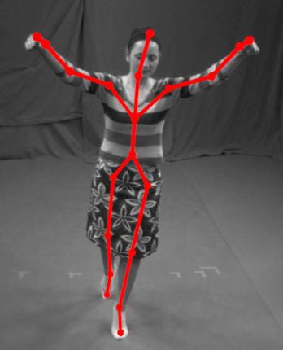
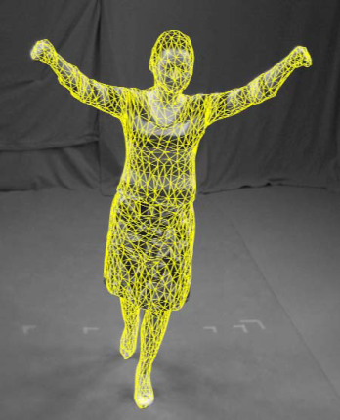
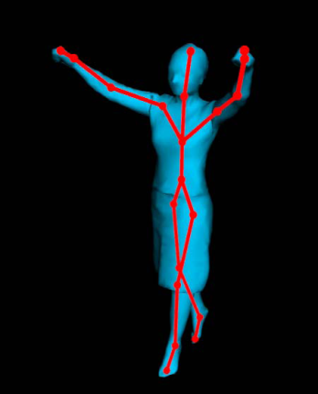
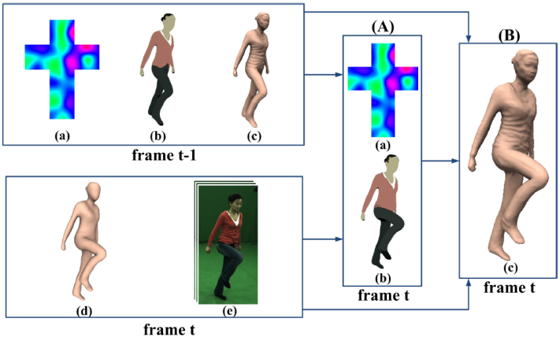
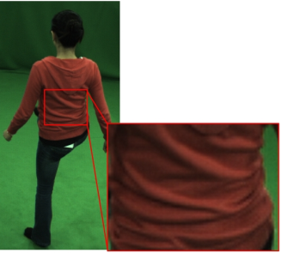
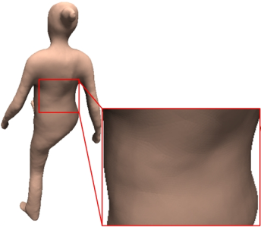
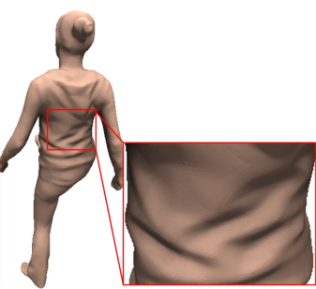
Background
Motion Capture and 3D Reconstruction
J. Gall, C. Stoll, E. de Aguiar, C. Theobalt, B. Rosenhahn, H.P. Seidel, Motion Capture Using Joint Skeleton Tracking and Surface Estimation. In Proc. of CVPR 2009.
Shading-based Dynamic Shape Refinement
Appearance reconstruction is still challenging!
C. Wu, K. Varanasi, Y. Liu, H.-P. Seidel, C. Theobalt, Shading-based Dynamic Shape Refinement from Multi-view Video under General Illumination. In Proc. of ICCV 2011.
Notes:
Using multi-view video recorded is the studio, recent advances in marker-less capture methods have made it possible to capture the motion and reconstruct geometry of actors. With the reconstructed 3D model, the captured performance can be viewed from arbitrary viewpoints.
<click>
With assistant of some prior knowledge about illumination and reflectance in a scene, the quality of reconstructed 3D also can be greatly improved.
<click>
However, besides geometry information, how to reconstruct a realistic appearance of the models is still challenging.

Slide 5
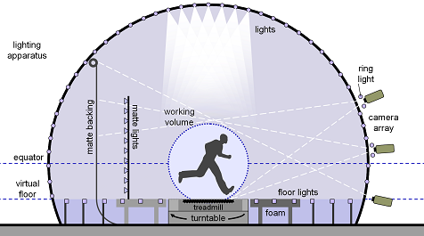
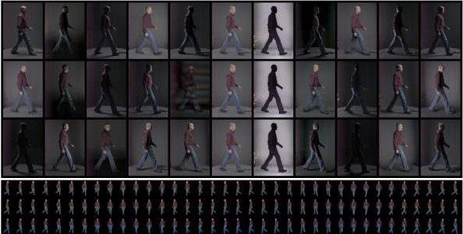
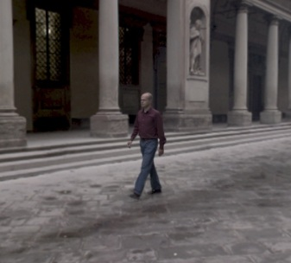
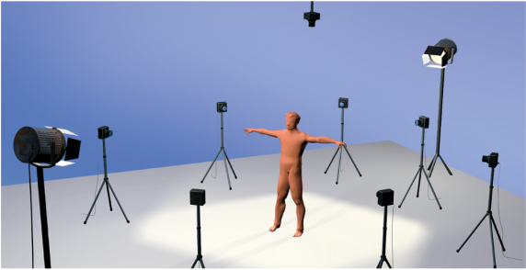
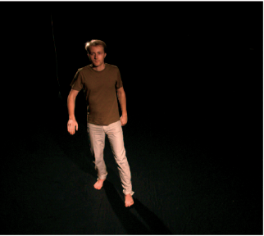
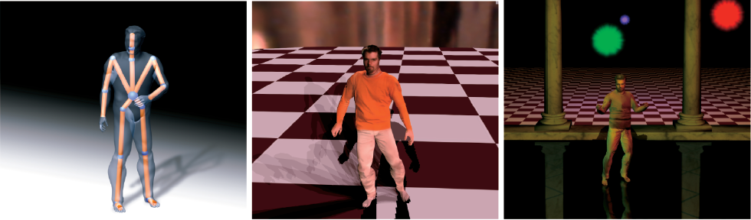
Background
Performance Relighting
P. Einarsson, C. Chabert, A. Jones, W. Ma, B. Lamond, T. Hawkins, M. Bolas, S. Sylwan, P. Debevec Relighting Human Locomotion with Flowed Reflectance Fields, In Proc. of EGSR 2006.
C. Theobalt, N. Ahmed, H. Lensch, M. Magnor, H. P. Seidel, Seeing People in Different Light: Joint Shape, Motion, and Reflectance Capture, in IEEE Transactions on Visualization and Computer Graphics, 2007.
Controlled lighting is required!
Notes:
To creating human performances in new incident lighting, some researchers used a fast light stage and high speed cameras for data recording. However, the complexity of this setup requires the motion to be simple and periodic.
For general human performances, Theobalt et al. <click> reconstructed a shape and motion of the actor using template-based motion estimation approach, and estimate a parametric BRDF model for each vertex to achieve relighting. In this work, the multi-view video recorded under the light of two calibrated spot lights.
<click>
So far, existing techniques required the incident illumination of the captured environment to be controlled or pre-calibrated.
So, how to estimate relightable versions of general human performance under general uncontrolled lighting that can be displayed from arbitrary viewpoints?

Slide 6
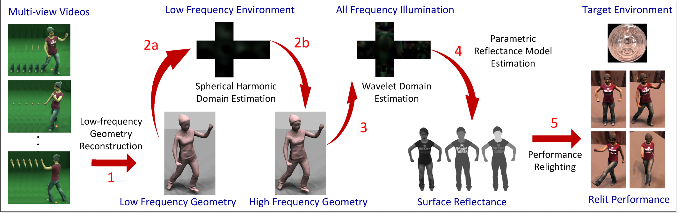
Motivation and Contributions
Coarse-to-fine Reconstruction
low-frequency
high-frequency
geometry
coarse mesh reconstruction
detailed fine-scale model
illumination
spherical harmonics
wavelet
reflectance
diffuse
Phong
Realistic appearance reconstruction under general uncontrolled illumination
Notes:
In this work, we resort to a cleverly designed coarse-to-fine reconstruction scheme to reach a plausible solution.
As estimating all parameters at the same time in high accuracy would be too difficult, we gradually refine the geometry, illumination and reflectance estimations fro low-frequency to high frequency.
Firstly, we reconstruct a faithful yet relatively coarse spatio-temporally coherent model of the actor.
Secondly, using this coarse scene
geometry, to get a rough incident lighting estimation and diffuse surface reflectance in spherical harmonics.
Then, we can spatio-temporally refine the surface geometry to recover previously missing fine-scale shape detail.
After this, an all-frequency representation of the incident illumination are estimated in the wavelet domain.
Finally, we estimate a spatially-varying parametric BRDF model for the dynamic shape which can also represent high-frequency reflectance effects.
<click>
Beyond detailed surface geometry, our approach also can reconstruct realistic appearance of the dynamic model under general uncontrolled illumination, and create plausibly relit performances in new incident lighting from arbitrary viewpoints.

Slide 7
Outline
Approach
  Data Capture
  Shape & Appearance Reconstruction
  Performance Relighting
Results
Future Work and Summary
Notes:
For more details about our proposed method, first, <click> let’s look into the data capture.

Slide 8
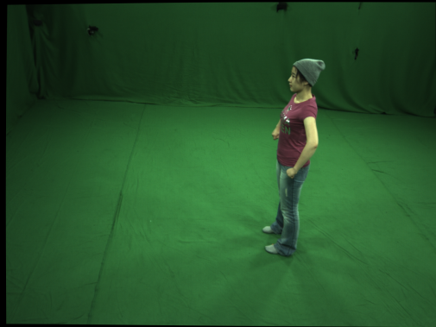
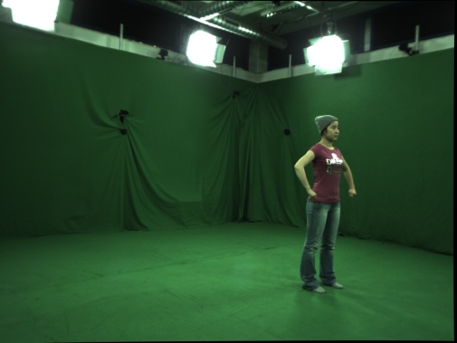
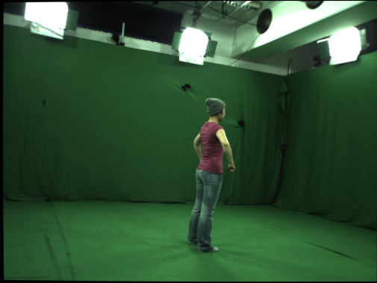
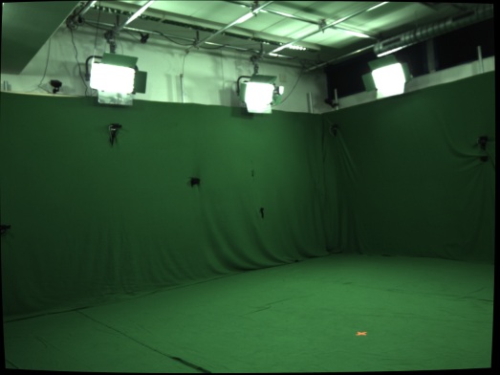
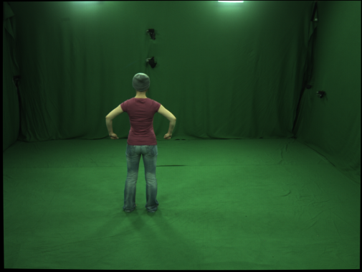
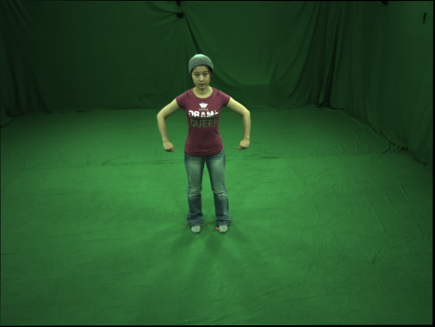
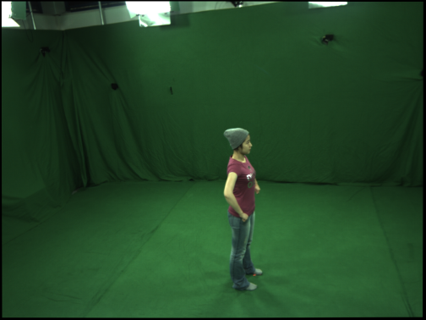
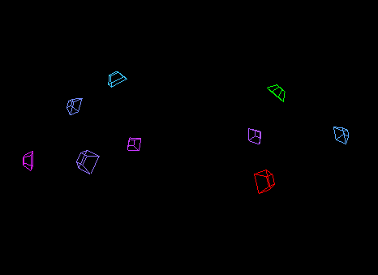
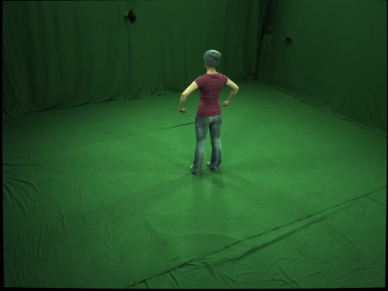
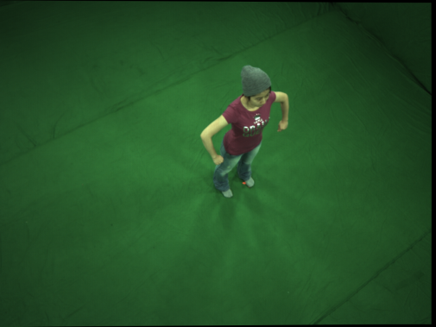
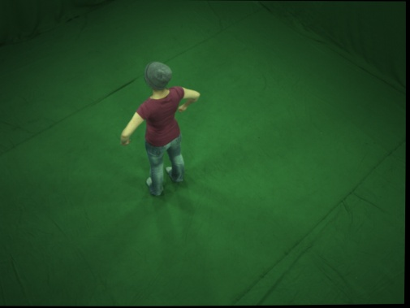
Approach - Data Capture
General Uncontrolled Illumination
Notes:
The left image shows a part of our recording studio. There are several area light sources in the top region of our studio. However, we do not impose strict requirements concerning the scene illumination during the reconstruction.
And this image shows the spatial camera distribution. Typically, 8 or 9 cameras are used in our work.
As shown in the right part, input to our system is a multi-view video sequence of a moving actor captured using a sparse set of synchronized cameras running at standard frame rate.

Slide 9
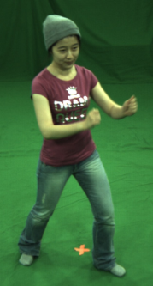

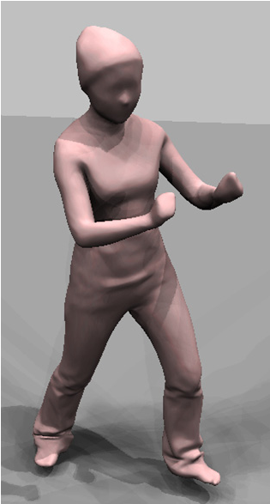
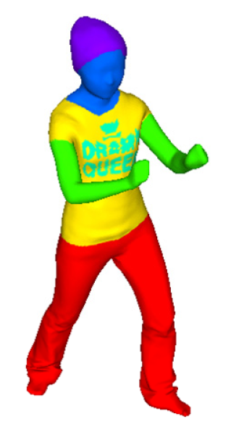
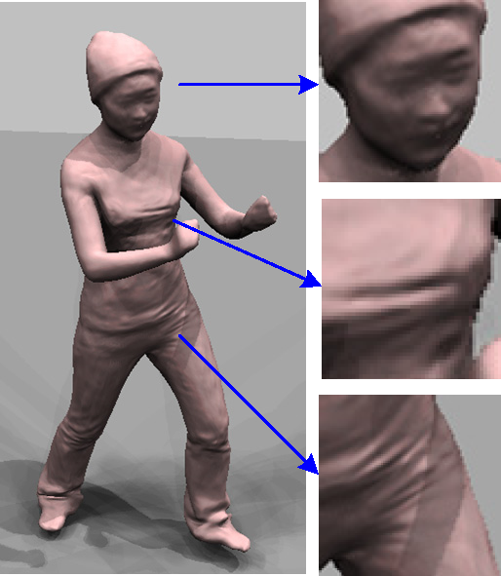
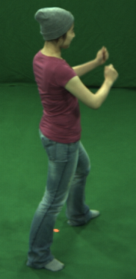
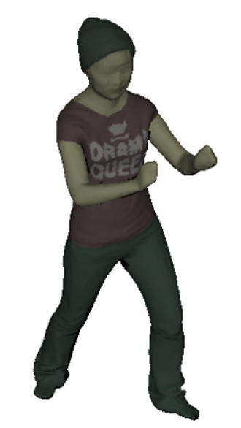
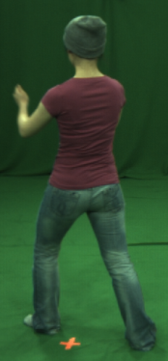

Approach - Geometry Estimation
Optimization in Spherical Harmonics Domain
Low Frequency Geometry
High Frequency Geometry
SH Environment
Material Segmentation
Diffuse Albedo
Shading-based dynamic shape refinement from multi-view video under general illumination. ICCV 2011
Notes:
Given the multi-view video footage, we first tack a smooth template to obtain the coarse low-frequency mesh reconstruction for each time step.
To recover fine-scale time-varying scene geometry from this coarse spatio-temporally coherent model, we employ a variant of one existing dynamic shape reconstruction method.
We assume the surface albedos belong to a set of K materials and want to determine the diffuse albedo label a^t of the vertices. In contrast to the previous shape refinement work, we require more accurate albedo estimates that are also suitable for our parametric reflectance estimation, where preservation of spatio-temporally coherent material boundaries is critical. Therefore, we develop a new method that generates a segmentation which uses a consistent set of materials for each time-step, preserves boundaries between materials on the surface, and is able to represent the potential shifting of material over the surface.
Assuming the material segmentation of the previous frame is given, we segment the mesh of the current frame by find the least energy configuration of this Markov-Randon-Field function. Here, the first item is a likehood data term that imposes individual penalties for assigning the label a_i to vertex i according ot the obeservation O, and the second one is a smoothness term.
Given the labels a^t of the mesh time t, we can update the albedo value for each label and estimate the incident lighting in the spherical harmonics domain.
Using the low frequency lighting and reflectance estimates, we then refine the dynamic geometry to get the time-varying fine scale surface details.
Seen from the zoom-in results, small-scale shape variation on the surface can be reconstructed faithfully.

Slide 10



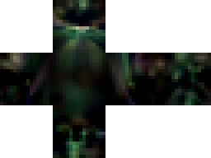
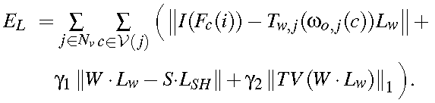
Approach - Illumination Estimation
All-frequency Lighting Estimation
Low Frequency Illumination
Rendering equation in wavelet domain
Regularizer
- SH estimation
- Total variation in spatial domain
SH Representation
High Frequency Illumination
Wavelet Representation
Notes:
With the improved model, we estimated high frequency incident lighting using wavelet.
In order to estimate non-Lambertian high-frequency reflectance properties of the surface, it is necessary to know the full-frequency incident illumination. However, the SH illumination estimated only represents a low-frequency approximation. To overcome this limitation, we refine the illumination estimation using a wavelet representation that can model all-frequency lighting.
Estimating the illumination from the images using only the rendering equation in wavelet domain is insufficient, as in the general case the problem is ill-posed, and noise may have a serious influence. Because of this we include the previously estimated SH basis illumination as regularizer, and add a smoothness constraint on the environment map. To prevent over smoothing of the lighting estimation, we minimize the total variation, which preserves the high-frequency structure of the lighting but prevents noise.
So the energy function for our all-frequency lighting estimation is consists of three parts: rendering equation in wavelet domain, regularizer considering the previous low-frequency estimates, and a smoothness term. And the intensity of the incident illumination is solved in each color channel respectively.

Slide 11
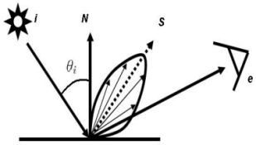
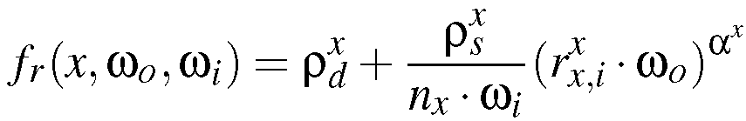
Approach - Reflectance Estimation
Parametric Reflectance Estimation
Phong BRDF Model
represent diffuse and specular surface reflectance based on a small set of parameters
Assumptions:
A set of base materials
Time invariant per-segment specular component
Time-vayring per-vertex diffuse albedo
Notes:
Given the estimate of the all-frequency illumination and detailed time-varying geometry, we now estimate the non-Lambertian reflectance of each surface point. To this end, we estimate the parameters of a Phong BRDF model for each vertex on the mesh surface at each time-step.
In this step, we select the Phong model since it enables us to represent diffuse and specular surface reflectance based on a small set of parameters. So it is a good compromise between modeling strength and computational complexity.
To recover the Phong BRDF parameters, we assume that,
->the surface of a human actor usually contain a set of base materials (similar to our previous segmentation).
->Specular albedo and shininess will be very similar in each material segment and are not vary over time.
->While, considering small alignment error and micro surface details that is not captured by our surface geometry, the diffuse albedo will exhibit stronger variations in a segment and may also change over time.

Slide 12
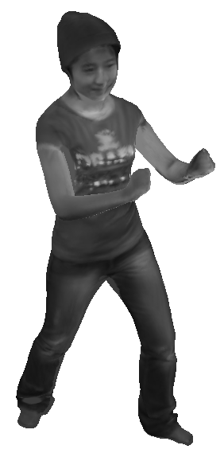
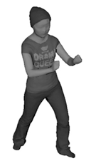
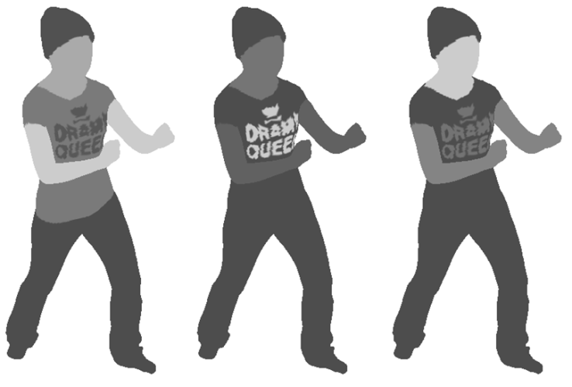
Approach - Reflectance Estimation
Parametric Reflectance Estimation
Per-segment Estimation
Per-frame Diffuse Update
Low Frequency Reflectance
High Frequency Reflectance
Diffuse Representation
Phong BRDF Representation
Notes:
So, we divide the reflectance reconstruction into two steps:
First, we estimate a single average BRDF for each material segment using a subset of the time-steps of the input sequence. As shown in this figure, diffuse albedo, specular albedo and specular exponent of the Phong BRDF model are estimation.
Then, based on the average BRDF parameters of each segment, we update the diffuse albedo of each vertex for each time-step to allow more accurate reconstruction of potential dynamic effects, like cloth shifting, facial expressions or moving micro-structure.
For better display, results here are shown in gray scale, and these are the estimates in red channel.

Slide 13
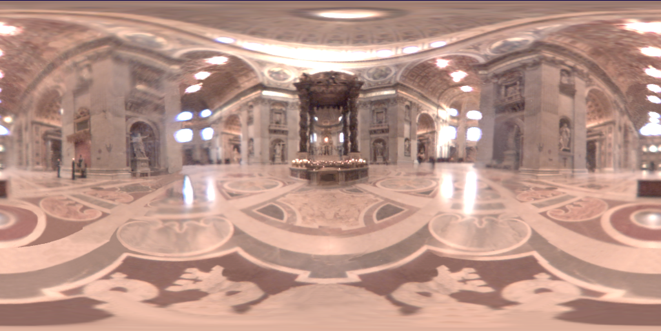
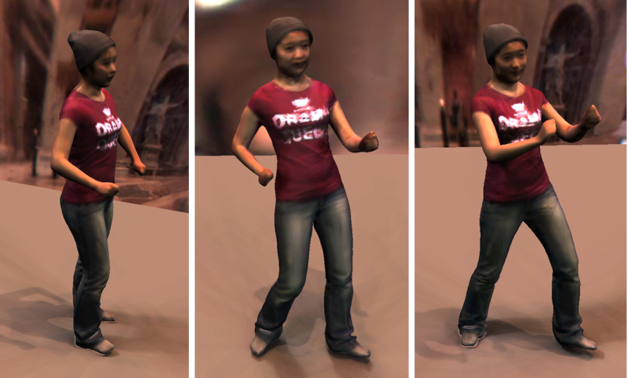

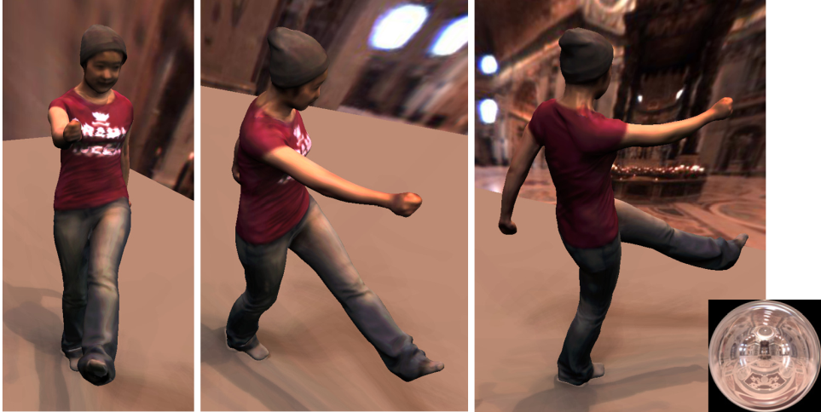
Approach - Performance Relighting
Median-cut Environment Sampling
256 light sources
4 frames per second
Notes:
With the reconstructed spatio-temporally coherent triangle meshes, and estimated BRDF for each surface point at each time step, we can now create novel virtual performances under an arbitrary new environment lighting from a novel camera.
To ensure interactive performance for our renderer, we use the median-cut algorithm to create n importance sampled directional light sources that approximate the target environment map. We render the geometry under each light source in parallel using a GPU based renderer for a novel camera, using shadow mapping to generate shadows; and combine the images into a final relit image.

Slide 14
Outline
Approach
  Data Capture
  Shape & Appearance Reconstruction
  Performance Relighting
Results
Future Work and Summary
Notes:
Now, let’s see some relighting results.

Slide 15
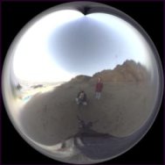
Results – kungfu sequence
Environment map Beach
Notes:
Here is the relit performance of kungfu sequence using the environment map Beach.
Seen from the video, specularity in the print of the t-shirt can be plausible captured and relit.

Slide 16
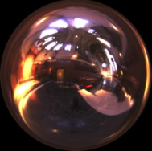
Results – dance sequence
Environment map Grace Cathedral
Notes:
Here is the relit performance of the dance sequence using the environment map Grace Cathedral.
The right-bottom corner shows four views out of nine views input video.
From this sequence, we can see that, the small-scale time-varying surface details, such as folds in clothing, are plausible captured and relit.
The slight specularities in the skin other fabrics also can be captured.

Slide 17

Results – dance sequence
Single light source
Notes:
Even under single light source, the relit performance is plausible.

Slide 18
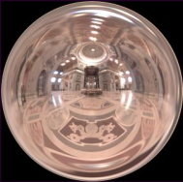
Results – samba sequence
Environment map St. Perter‘s Basilica
Notes:
Here is the relit performance of another sequence, samba, using the environment map St. Perter's Basilica.
The right-bottom corner shows four views out of eight views input video.
Please note that, the multi-view video data set of this sequence was downloaded from the web. Its recording was thus not under our control, and no information about incident illumination for that particular scene is available.

Slide 19
Results – samba sequence
Environment map Grace Cathedral
Notes:
Here is the relit performance of samba using the environment map Grace Cathedral.
You may observe that there are some artifacts in the forehead region.
Due to calibration inaccuracies in the cameras, noise in the input images, and simplified assumptions in the reconstruction process, our geometry will not be accurate up to millimeter scale. If errors are larger, this may lead to ghosting artifacts in the reconstruction.
Even though our full pipeline cannot guarantee fully-accurate reconstructions of geometry, reflectance, and illumination, our results nevertheless are plausible.

Slide 20
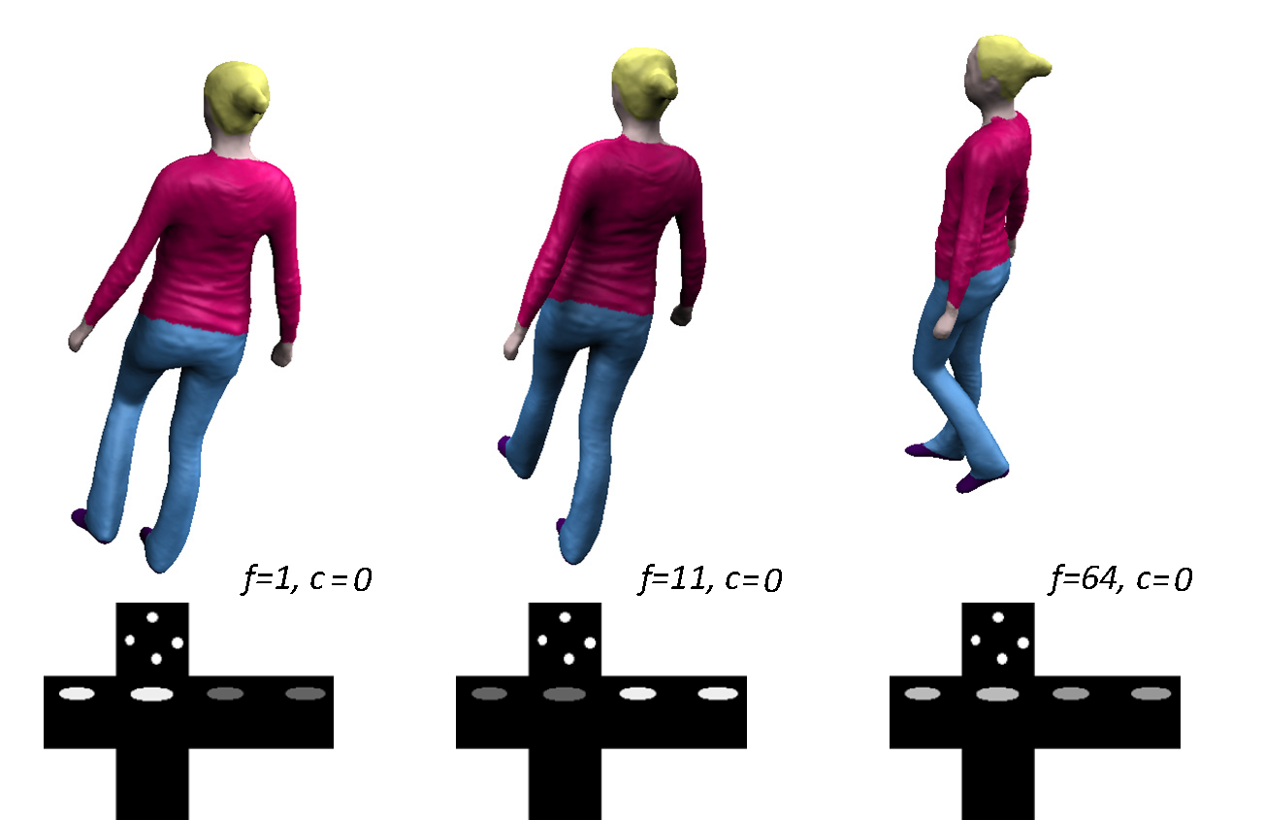

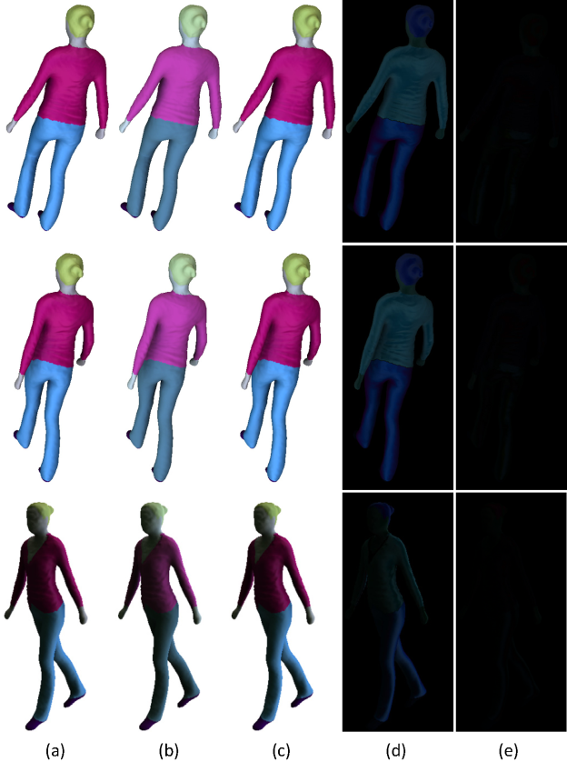



Results – synthetic sequence
10 virtual cameras, 100 frames,
time varying illumination
Quantitative Evaluation
Time-varying illumination
v.s. SH based BRDF
v.s. diffuse BRDF
SH based BRDF error:
(0.0392, 0.0591, 23.846)
(a): Ground
truth BRDF
Full pipeline BRDF error:
(0.0392, 0.0591, 23.846)
(b): Diffuse
BRDF
(c): Phong
BRDF
(d): Diffuse
relit error
Ground Truth
SH
Estimation
Wavelet
Estimation
(e): Phong
relit error
Notes:
To evaluate our approach quantitatively, we generated a 100 frame synthetic sequence of a 3D model from 10 virtual cameras under time varying illumination.
We manually specified BRDF parameters for the surface, so that ground truth reflectance would be available.
Using this synthetic sequence, we analyze the importance of our various algorithmic steps.
<click>
First, we validate that our method can handle time-varying lighting. As shown in this figure, the spherical harmonics estimation hardly captures the variation in the incident illumination, while our new pipeline reliably captures both the layout of the lights, as well as the time-varying changes in their intensities more accurately.
To emphasize the importance of reconstructing high frequency incident illumination, we compare our full all-frequency reconstruction pipeline against Phong BRDF reconstruction that uses only low-frequency SH-based illumination estimation.
<click>
The reconstructed BRDF parameters of our full pipeline is more accurately than the SH-based estimates.
The biggest improvement can be found in the more accurate estimation of the specular components, which is very important for a plausible visual appearance and is one of the major benefits of our approach.
We also compare our new full reconstruction pipeline against the purely diffuse reflectance estimates obtained with the approach by Wu et al.
<click>
As shown in this figure, specularities cannot be reproduced using their purely diffuse BRDF model. In contrast, since we are performing albedo clustering in a way that is better suited to our setting, and since we estimate both high frequency reflectance and illumination, our results capture the true appearance of the scene much more accurately.
As shown in Figure(c) and (e), results of our method almost show no difference to the ground under the novel illumination.
Based on this synthetic sequence, the superiority of our method is also confirmed quantitatively.

Slide 21
Outline
Approach
  Data Capture
  Shape & Appearance Reconstruction
  Performance Relighting
Results
Future Work and Conclusion
Notes:
Finally, let’s conclude with future work and summary of our work.

Slide 22
Future Work
Combination with super-resolution approaches for better visual quality
Considering global illumination
More complex BRDF model
Outdoor performance capture
Notes:
Currently, the reconstruction results are limited by the resolution of the input videos. We cannot reconstruct reflectance and geometry smaller than a pixel’s size. This also limits the image resolution and zoom level at which performances can be rendered convincingly. Combination with super-resolution approaches may improve the visual quality.
<click>
And, our reconstruction currently considers only direct illumination coming from infinitely far light sources. This is in general not true, but the negative influence of this assumption on the reconstructions is reduced by considering local visibility and the ambient occlusion term in the BRDF estimation. We acknowledge that more advanced segmentation approaches exist that could be used to separate local and global effects.
<click>
And more complex BRDF models will be investigate in the future. The Phong model used in our BRDF estimation is not suitable for all input materials. For example, the appearance of human skin exhibits subsurface-scattering effects may be reconstructed better by a more complex model.
<click>
Finally, even though all our current examples were captured indoors, we believe that our work paves the way for relightable performance capture on outdoor sets, and this opens a new direction in movie post-production.

Slide 23


Conclusion
Summary
Capture detailed time-varying geometry, incident lighting, and spatial-temporally varying reflectance of the surface
Reconstruct non-Lambertian appearance from multi-view video under uncontrolled illumination
Capture relightable performance without complex controllable light setups
Limitation
Direct illumination coming from infinitely far light sources
Using Phong model to represent the appearance of human skin
Limited by the resolution of input videos
Notes:
In the end, let’s summarize some key points of this work.
We present an approach that can capture detailed time-varying geometry, incident lighting, and spatial-temporally varying reflectance of the moving surface, and even the non-Lambertian appearance can be reconstructed plausible. More importantly, our method enables plausible reconstruction of relightable dynamic scene models without a complex controlled lighting apparatus.
There are also some limitations of our current method, and further investigations will help us to solve this problem better in the future.
Thank you very much!

