Slide 1
Video-based Characters Creating New Human Performances from a Multi-view Video Database
Feng Xu＊ Yebin Liu＃ Carsten Stoll＃ James Tompkin☆ Gaurav Bharaj＃
Qionghai Dai＊ Hans-Peter Seidel＃ Jan Kautz☆ Christian Theobalt＃
＊ ☆ ＃
Notes:
Our work is titled Video-based Characters, Creating New Human Performances from a Multi-view Video Database. This work is coauthored with Yebin Liu, Carsten Stoll, James Tompkin, Gaurav Bharaj, Qionghai Dai, Hans-Peter Seidel, Jan Kautz and Christian Theobalt.

Slide 2
Motivation
Walk
Jump
Target: Kung-fu
Punch
Kick
Our method automatically synthesizes photo-realistic videos of characters performing user-defined motions, observed from user-defined viewpoints.
Notes:
Our method aims to automatically synthesize photo-realistic videos of characters performing user-defined motions, observed from user-defined viewpoints.
To achieve this, we capture a multi-view video database containing short clips of basic motions. We can see some of the basic motions here, like walk, jump, punch and kick. Then we ask the user to define a target motion and a target viewpoint. The target motion and viewpoint need not be part of the database. Our method synthesizes target videos, one of which is shown here: a user-defined KungFu motion is captured from a user-defined viewpoint.
%Order of the sentences
%Make all blue the same

Slide 3
Related Work
 | Fully editable performance | Fully animated view points | Photo-realistic video sequences
Video games | ● | ● | ○
Movie productions | ● | ● | ●
? | ● | ● | ●
LABOUR INTENSIVE
Notes:
In current video games, animation techniques are highly developed. Fully editable performances and fully animated view points are both achieved. However, the rendered videos are not as realistic as a captured video.
In movie productions, the resulting videos are realistic. However, creating photo-realistic virtual actors takes a very long time (often weeks or months of work), and it is a tremendous effort to create a photo-realistic appearance of an actor for a new pose and a new viewpoint.
We believe that any new technology should allow full animation control and generate photo-realistic imagery with a minimal amount of manual work.
%Related work
%Fully editable performance
%put a bar on movie production(all green)

Slide 4
Related Work
Model based [Zitnick et al. 2004; Matusik et al. 2000; Tung et al. 2009; Carranza et al. 2003; Ballan and Cortelazzo 2008]
Image based [Wilburn et al. 2005]
 | Fully editable performance | Fully animated view points | Photo-realistic video sequences
Video games | ● | ● | ○
Movie productions | ● | ● | ●
Novel viewpoint synthesis | ○ | ● | ●
LABOUR INTENSIVE
Notes:
Previous works in the literature have focused on novel viewpoint synthesis. These techniques have fully animated view points and photo-realistic synthesis. However, they can not create new performances from the captured characters.

Slide 5
Related Work
Face shape [Leyvand et al. 2008; Kemelmacher-Shlizerman et al. 2010]
Body shape [Zhou et al. 2010; Jain et al. 2010]
Pose: rigid vs. non-rigid [Hornung et al. 2007; Cobzas et al. 2002]
 | Fully editable performance | Fully animated view points | Photo-realistic video sequences
Video games | ● | ● | ○
Movie productions | ● | ● | ●
Novel viewpoint synthesis | ○ | ● | ●
Novel appearance synthesis |  | ○ | ●
LABOUR INTENSIVE
Notes:
Some other works focus on Novel appearance synthesis. They alter the face shape, body shape or pose somewhat, but they do not allow performances to be changed much from the original sequence. We say that they allow partly (not fully) editable performance.

Slide 6
Related Work
[Schödl et al. 2000; Schödl and Essa 2002; Celly and Zordan 2004; Mori et al. 2004; Flagg et al. 2009]
 | Fully editable performance | Fully animated view points | Photo-realistic video sequences
Video games | ● | ● | ○
Movie productions | ● | ● | ●
Novel viewpoint synthesis | ○ | ● | ●
Novel appearance synthesis |  | ○ | ●
2D video texture |  | ○ | ●
LABOUR INTENSIVE
Notes:
Video textures is another related topic. It rearranges captured videos to create new endlessly looping videos. However, it does not allow a change of view point and is limited to the content in the captured performances.

Slide 7
Related Work
[Starck et al. 2005; Huang et al. 2009]
 | Fully editable performance | Fully animated view points | Photo-realistic video sequences
Video games | ● | ● | ○
Movie productions | ● | ● | ●
Novel viewpoint synthesis | ○ | ● | ●
Novel appearance synthesis |  | ○ | ●
2D video texture |  | ○ | ●
3D performance motion graph |  | ● | ●
LABOUR INTENSIVE
Notes:
3D performance motion graph techniques concatenate existing sub-sequences, and allows view point to be changed. Still, it is not possible to create arbitrary new animations from the captured performance.
%3D performance motion graph

Slide 8
Related Work
 | Fully editable performance | Fully animated view points | Photo-realistic video sequences
Video games | ● | ● | ○
Movie productions | ● | ● | ●
Novel viewpoint synthesis | ○ | ● | ●
Novel appearance synthesis |  | ○ | ●
2D video texture |  | ○ | ●
3D performance motion graph |  | ● | ●
Our work – Video-based Characters | ● | ● | ●
LABOUR INTENSIVE
Notes:
Our work video-based characters attempts to provide full control over the pose of a character and the view point, while requiring very little manual work. Our work also attempts to generate photo-realistic video sequences with time-varying and motion-specific texture detail.

Slide 9
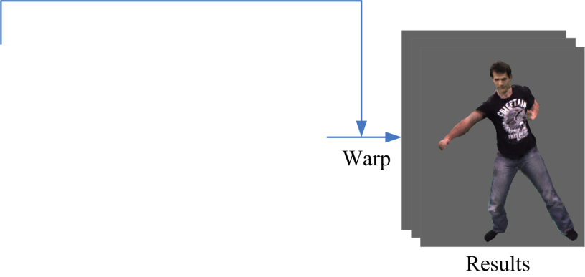
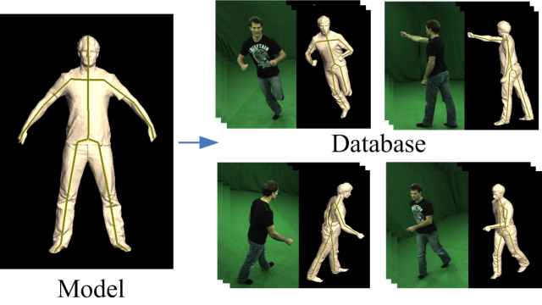
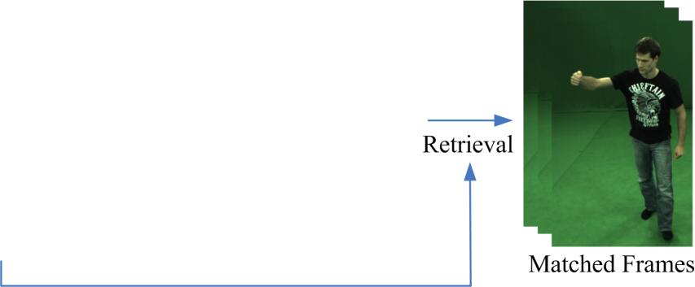
Outline
Database
Query
Retrieval
Video Synthesis
Notes:
Our method has 4 major steps. The first step is to build a database of performances captured in a multi-view studio. The second step is to define our target pose and viewpoint. This we call the ‘query’. The query motion need not be part of the database, and can be very different. Third, we perform retrieval from the database to find matched frames for synthesizing the query. Finally, we warp the matched frames to the target to achieve the result.
%Image resolution
%Mention simple motions again
%Build the figure up
% JAMES: I’ve removed some language about ‘arbitrary’ poses and viewpoints as we were scolded for this in the reviews.

Slide 10
Outline
Database:
Multi-view frames, 3D skeletons and mesh surfaces.
Notes:
As stated, the first step is to build a database. The database contains multi-view frames of a character performing various basic motions. For each frame of multi-view video the database also contains a 3D bone skeleton and a deformed mesh surface.

Slide 11
Multi-view database
3D scan & skeleton embedding:
Notes:
We first perform a 3D body scan of the actor to obtain a 3D mesh model and manually insert a skeleton into the model.

Slide 12
Multi-view database
Multi-view capture & motion tracking:
Notes:
We then capture multi-view video sequences. We fit our 3D model to the captured images and track it in the video sequences. This provides a skeleton-based performance capture with a mesh model and a skeleton corresponding to each time step. We stress that there is no specific set of motions that must be captured: a basic set of simple motions such as walking and jumping is sufficient to build a large range of target animations.
The skeletons, mesh models, and captured multi-view sequences form our database.
%JAMES: Perhaps talk just a little bit more (one sentence) about how this is performed from segmentation masks.

Slide 13
Outline
Query:
Skeleton sequence and camera sequence.
Notes:
In the second step, The user defines a query sequence. The query sequence contains a skeleton sequence describing the motion of the character and a camera sequence describing the viewpoint for capturing the character.

Slide 14
Skeleton & Camera
Skeleton sequence:
Skeleton animation.
Motion retargeting.
Camera sequence:
Camera animation.
Camera tracking.
Notes:
To create the query skeleton and camera, animators are free to use the standard set of tools with which they are familiar.
For instance, skeleton motion can be keyframed in tools like Maya, or motion capture data can be used and retargetted.
Similarly, cameras can be defined in 3D animation packages, or obtained by other means, such as with a camera tracker - we will show examples of this later in the talk.
Here we show a skeleton sequence viewed from a camera sequence.

Slide 15
Outline
Retrieval:
Pose and view similarity.
Temporal consistency.
Notes:
The third step in our approach is the retrieval procedure. We find database frames that are good for synthesizing query frames.
Two things are required:
1) A pose and view similarity measure to find the closest frames in a database, and
2) A retrieval approach that uses the pose and view similarity measures to create a spatio-temporally coherent texture pattern in the output animation.

Slide 16
Similarity
Frame distance:
Camera distance:
Pose distance:
Visibility Score:
√ efficient
×less accurate
The number of mesh facets that are visible from both views.
√ more accurate
×complex
Notes:
To perform retrieval, first we need to define the similarity between one query frame and one database frame.
We proposed two similarities. One is based on the frame distance. It has two components: the pose distance and the camera distance. The camera distance is the Euclidean distance between the two camera centers. The pose distance is the normalized distance between all corresponding joints of the two skeletons.
The other similarity is based on the visibility score. We first render the query mesh model to the query camera, and also render the database model to the database camera. Given these renderings, the visibility score is defined as the number of mesh facets that are visible from both the views.
The frame distance is efficient but less accurate. The visibility score is more accurate but it is more complex and so takes longer to compute.
%Approximate, heuristic, less accurate

Slide 17
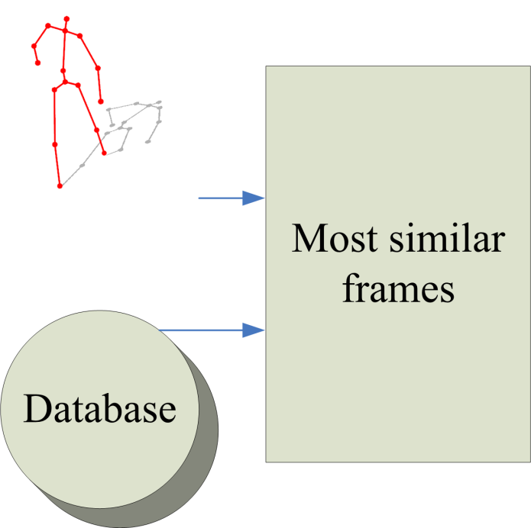
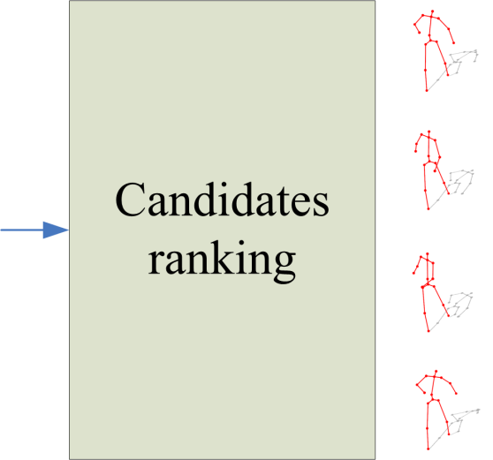
Candidates
Establish multi-candidates by the frame distance.
Rank the candidates by the visibility score.
Notes:
With our similarity metrics, we could set the result to be the most similar database frames for all query frames. However, temporal consistency is not guaranteed with this approach.
So for each query frame, we first use the frame distance to find 100 similar database frames. Henceforth we call them candidate frames. Here, we use the frame distance because it is more efficient.
Then we use the visibility score to rank the candidates. Because the visibility score is more accurate.
So, for each query frame, we have 100 ranked candidates.
JAMES: I still have issues with this slide: the diagram is really unappealing – please could the images be a diagram in powerpoint instead? I tried to make changes

Slide 18
Candidate Ranking
1.
100 most similar frames
2.
Frame distance
Visibility score
Candidate ranking
Query
Database
…
100.
Notes:
With our similarity metrics, we could set the result to be the most similar database frames for all query frames. However, temporal consistency is not guaranteed with this approach.
Instead, for each query frame we first use the frame distance to find 100 similar candidate database frames. We use the faster frame distance to reduce the database down to this smaller number.
Then we use the more expensive but more accurate visibility score to rank these candidates.
For each query frame, we now have 100 ranked candidates.

Slide 19
Sequence-to-sequence Matching
Build candidate sequences:
Choose “good” candidate sequences:
High ranking
Similar motion energy
Long sequence
Similarity
Temporal consistency
Notes:
Then we propose our sequence-to-sequence matching procedure. From the ranked candidates, we will find subsequences that match the query sequence.
Suppose we have 4 candidates for each query frame. We first connect consecutive candidates of every two query frames. The procedure is shown here. Consecutive candidates are corrected gradually. We see these two green frames are connected because they are both from motion sequence 1, captured by camera 6. And their frame labels are consecutive. Then we obtain all possible candidate sequences like this green sequence which has 3 frames, and this blue sequence which has 6 frames.
Among them, we choose good candidate sequences as the retrieval result. A good sequence contains frames with high rank and has similar motion energy to the query. The motion energy describes the amount of motion in a sequence. With the help of the motion energy, we are able to prevent a slow motion sequence matching a query sequence with fast motion. These two factors guarantee high similarity to the query. Also, a good sequence should contain many frames. This is for temporal consistency.
% “guarantee high similarity” – bold claim.
% JAMES: Missing right-side vertical lines on boxes 1, 4, 5 and 8 on my display.

Slide 20
Main Retrieval
Frame-to-sequence matching:
Use current best candidate.
Test the similarity between the previous retrieval result and the current query frame:
If it is high, use it again (Temporal consistency).
If not, use the current best candidate (Similarity).
Notes:
After the sequence-to-sequence matching, there are still some query frames with no matches. Here, we show an example – in this case, there are no good candidate sequences matching the query.
Suppose we have 3 consecutive query frames with no matching sequence. In this frame-to-sequence matching procedure, we will find matches for those frames. For the first frame, we use the current best candidate as the retrieval result. For the following query frames, we test the similarity between the previous retrieval result and the current query frame. If the similarity is high, we use the previous retrieval result. This considers temporal consistency. If the similarity is not high, we switch to the current best candidate. This is to guarantee higher similarity if there is no temporal consistency.
After this frame-to-sequence matching procedure, all frames will have matches.

Slide 21
Face Retrieval
Limitation:
Face coherence not ensured during retrieval.
Method:
Single best database frame.
×discontinuity
×multi-frames
√ coherence
√ single frame
Notes:
The above retrieval has one limitation. Human perception is tuned to recognize faces; however, face coherence is not ensured during retrieval.
Due to view and pose difference, pixel data from several different source frames usually need to be warped to the target to create a complete face. Since the face geometry of our model is not 100% accurate, discontinuities may appear in the final result.
To solve this problem, we develop a special procedure for face retrieval. By considering the face coherence, we use the single best database frame from which to copy over the entire head texture (similar to the frame-to-sequence matching). In this way, we get better result for the head as shown in this figure.

Slide 22
Outline
Video Synthesis
Notes:
The 4th step is video synthesis. We use the query information to warp the matched frames to synthesize the final result.

Slide 23
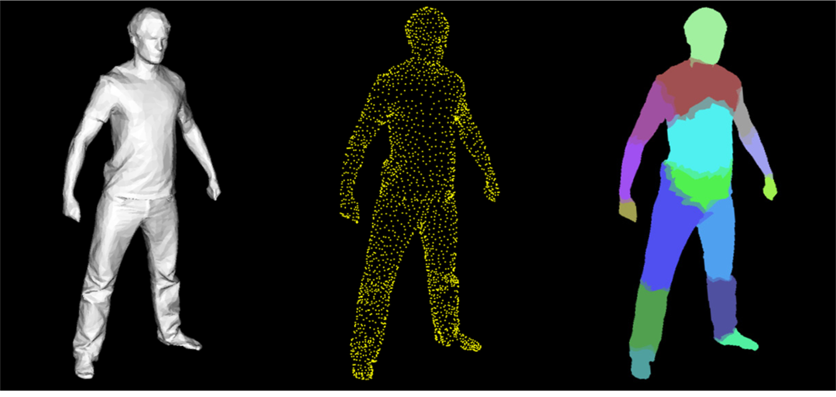
Single frame warping
MLS warping based on vertex projection.
Body-part dependent warping.
3D mesh model
Model vertices
Body part partition
Notes:
Since we fit 3D models to both the query frame and the database frame, we can use vertex correspondences to guide the warping from the source to the target. We use moving least squares warping. As different body parts may have different motions, we perform a body-part dependent warping to ensure that arm pixels are not warped onto the torso (for instance).
%Figure label

Slide 24
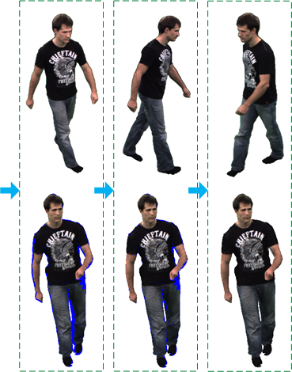
Multi-frame integration
Finally, fill holes by warping from other multi-views.
First, warp the matched face frame.
Next, warp the matched body frame.
Notes:
Since one source frame may not have all the information for synthesizing the corresponding query frame, we use multi frames. Firstly, We warp the head region of the matched face frame to the target. Here, blue means pixels are still not textured at current step. Secondly, we warp the matched body frame. Thirdly we warp frames with the same pose of the matched body frame but captured by other cameras. A complete target image is obtained after spatial blending of the warping results from different images.
%Put labels underneath
%Talk about the blue region
%Take all the cameras the same pose but other cameras

Slide 25
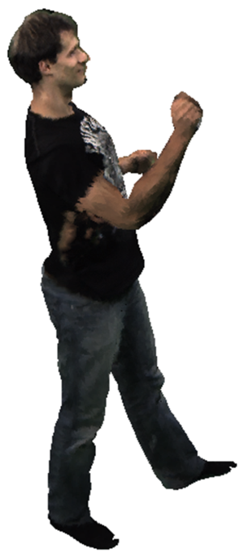
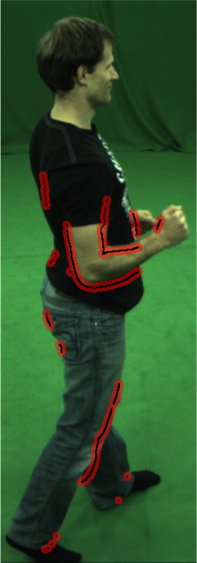
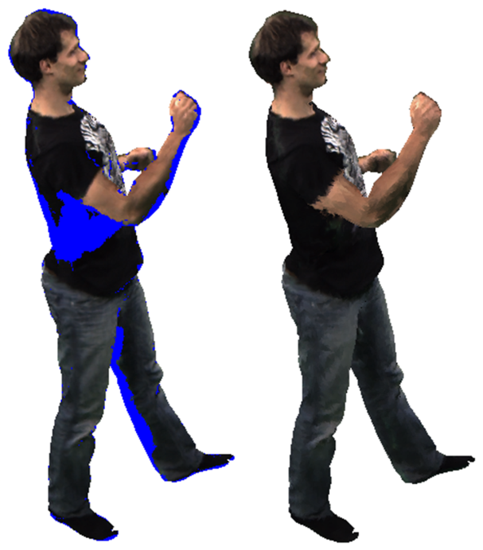
Deghosting
Ghosting: caused by inaccuracies in the tracked 3D mesh.
Ignore pixels if they are close to depth continuities and body part boundaries.
Notes:
Due to small inaccuracies in the tracked 3D mesh, its projection will never align exactly with the database frames, and pixels may be matched with incorrect body parts. These mismatches lead to ghosting artifacts, which are visible here circled in red.
We detect the occurrence of these artifacts using depth and body part information. Ghosting is likely to originate from areas around depth discontinuities and body part label discontinuities.
Thus, we ignore pixels if they are close to a depth and body part label discontinuities. You can see the better result here…
%Animate the figs
%resolution

Slide 26
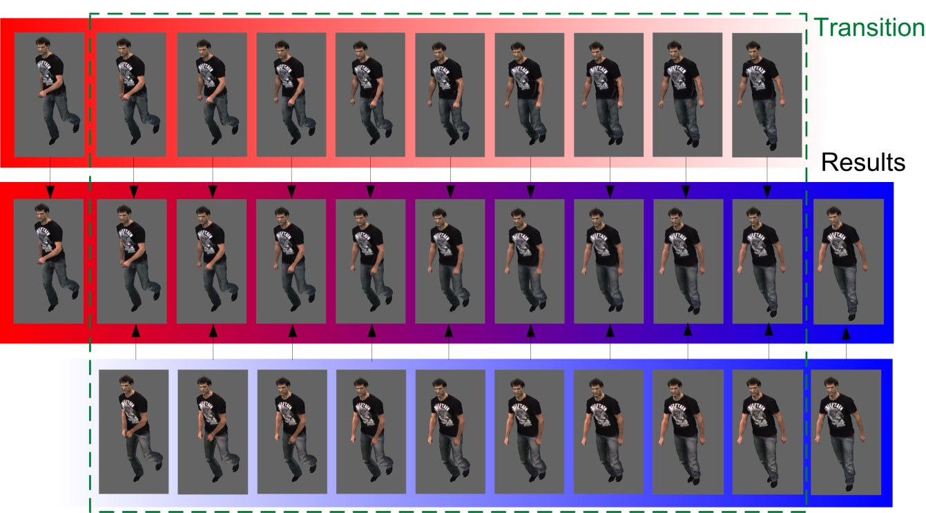
Temporal Smoothing
Consecutive target images are synthesized from very different database images.
Smoothly blend between consecutive sequences.
Sequence 1
Blended Result
Sequence 2
Notes:
Noticeable temporal jumps can occur when consecutive target images are synthesized from very different database images.
To solve this problem, each target frame is synthesized twice from two different matching sequences. A smooth transition is achieved by blending the two results. The blending weight is depended on the frame position in the transition and is color coded in this figure.
%Resolution
%Temporal smoothing

Slide 27
Results
Notes:
We now show video results. First is the Kongfu Sequence. We use motion retargeting to transfer the same Kongfu motion to the two characters. We can see that each two characters is performing exactly the same motion.

Slide 28
Results
Notes:
This result shows the character performing a catwalk sequence. The query motion was downloaded from a motion capture database. To the bottom right we see the retrieved subsequences from the database which are used to synthesize the target animation.

Slide 29
Results
Notes:
In this marching sequence, the motion energy term helps to make sure that the texture and cloth fold patterns for the back, which correspond to energetic motion in the query, is taken from source frames with similarly energetic motion.
%Folders are realistic
%Mention energy mentions(how to mention?)

Slide 30
Results
Notes:
We can also composite our characters into real world video. We use a camera tracking technique to obtain the camera parameters of a captured background video, and use this as the query viewpoint. Then, we can superimpose our character into the background, estimate a ground plane, and render shadows.

Slide 31
User Study
Notes:
To assess the quality of our results, we conducted a user study, asking subjects to compare the quality of differently generated target animations against a ground truth video of the actor. Details can be found in the paper.
Here is an example. We compare the ground truth video and the video obtained by static texture mapping. Study participants found that a statically textured model looks very unrealistic, as you can see here, since the dynamics of natural videos is missing entirely.
%Three videos: speak more about the user study
%Three messages

Slide 32
User Study
Notes:
In contrast, participants found that our result, shown on the right here, looks much more realistic and closer to the real result.

Slide 33
User Study
Notes:
Our user study also revealed that it is essential to maintain temporal coherence in the final results. Just using the best database frame for every target animation time step leads to very disturbing temporal artifacts, as shown on the left.

Slide 34
Conclusion
Method to create realistic video animations of human actors:
large range of user-defined motion .
user-defined camera view.
New spatio-temporal retrieval and texture warping method.
Based on performance capture data from a sparse multi-view video database.
Notes:
Here, we conclude our paper. Our method creates realisic video animations of human actors with large range of used-defined motion and used defined camera view.
We propose mew spatio-temporal retrieval and texture warping method.
Our approach is based on performance capture data from a spars multi-view video database.

Slide 35
Acknowledgments
in Saarbrücken, Germany.
National Basic Research Project, NSFC grants, and the 863 Program (from China).
The UCL EngD VEIV center and BBC Research & Development.
Notes:
We would like to thank to the Intel Visual Computing Institute along with funding from China and the UK.

Slide 36
Thank you
Notes:
Thank you for your attention.
%Real world

