Slide 1

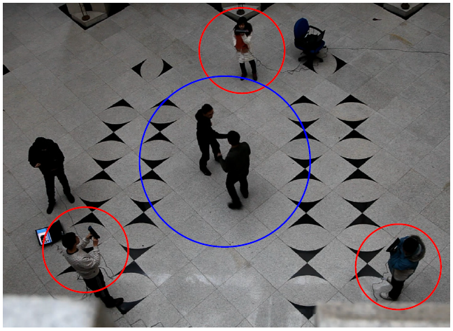
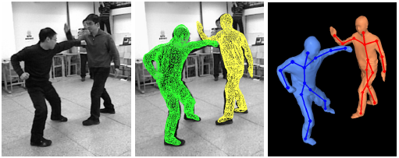
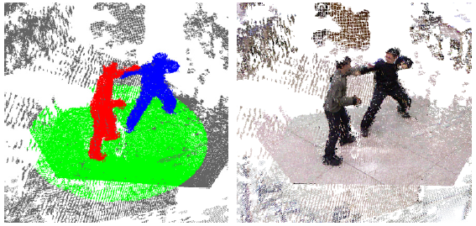
Research outline
Performance Capture Using Multiple Handheld Kinects [Accomplished]

Slide 2
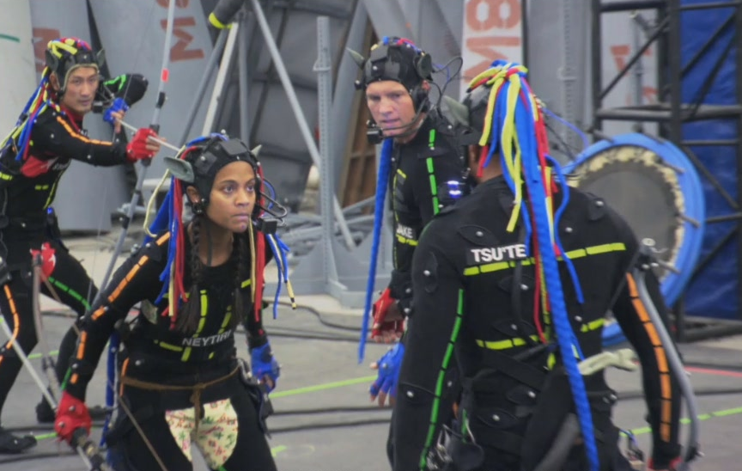
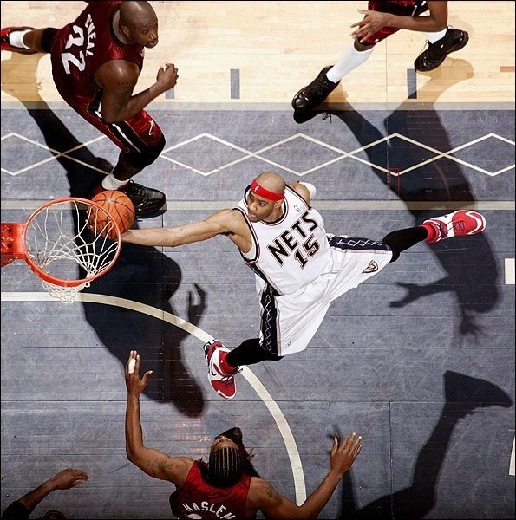
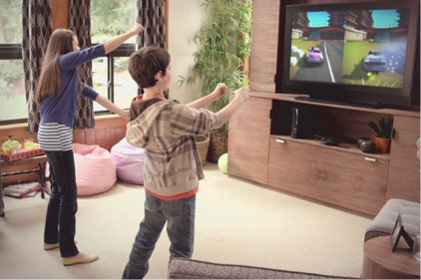
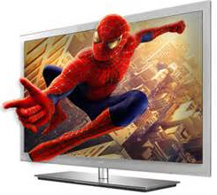

Background of Performance capture
Commercial application
  Movie production
  Sports 3D live show
  Motion sensing game
  3D Television
  ······
Motion capture
Free viewpoint video
Research community
  Markerless motion capture
  Dynamic 3D reconstruction
  Human computer interaction
  ······
Motion sensing game
3DTV

Slide 3
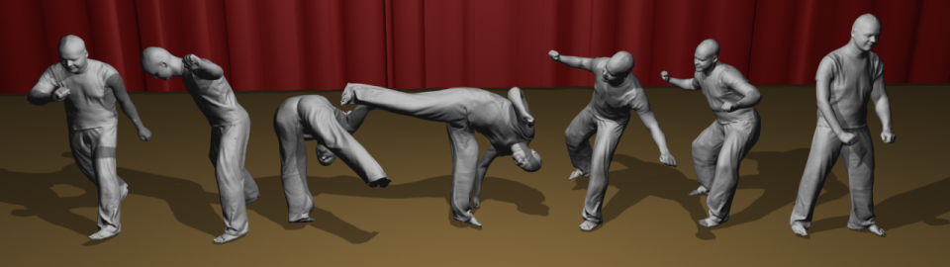
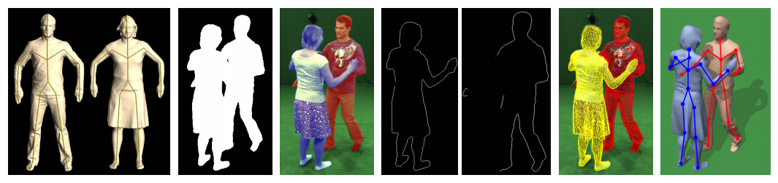
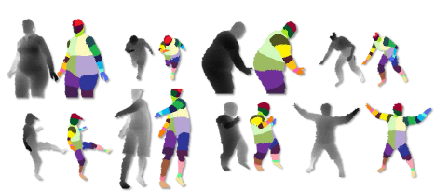
Previous works
From multi-view RGB video
  Mesh tracking
    [Starck et al. 2007] and [De Aguiar et al. 2008]
  Skeleton and surface
    [Gall et al. 2009] and [Vlasic et al. 2008]
  Interacting characters
    [Liu et al. 2011]
From monocular depth video
  Probabilistic inference
    [Ganapathi et al. 2010]
  Body part recognition
    [Shotton et al. 2011]
Complex and expensive studio setting
Only limited frontal pose estimation

Slide 4
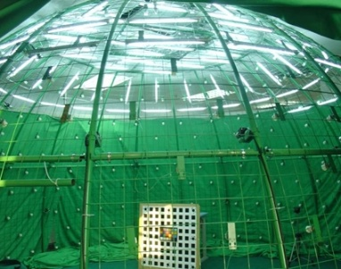
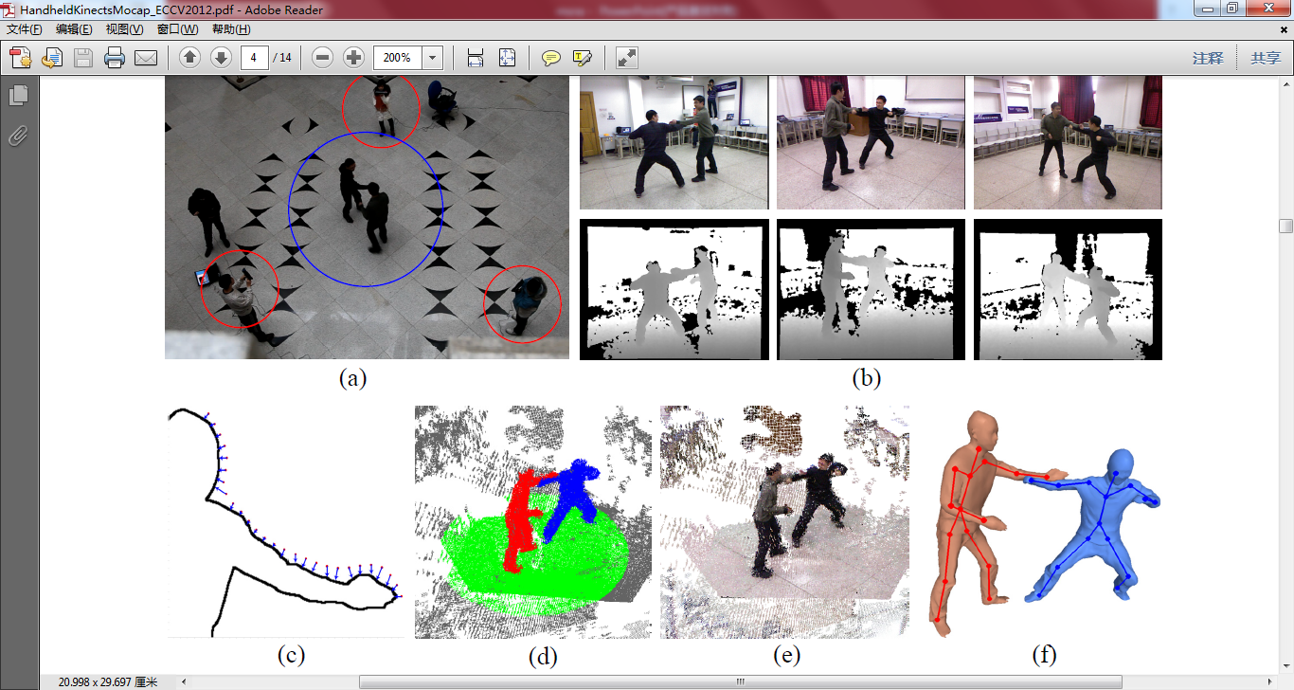
Motivation
An end-to-end full-pose performance capture system using multiple handheld Kinects which is accurate, robust, practical and low-cost!!!
 | Capture environment | Algorithm
Limitation
Breakthrough
Strictly controlled Lab setting
10+ calibrated cameras
Articulated template tracking
using 2D image silhouette
and feature
General indoor scene
3 freely handheld Kinects
Simultaneously motion
reconstruction and Kinect
localization

Slide 5
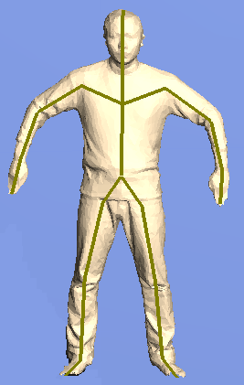
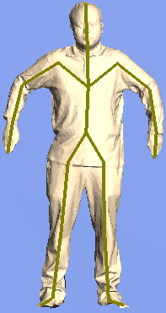
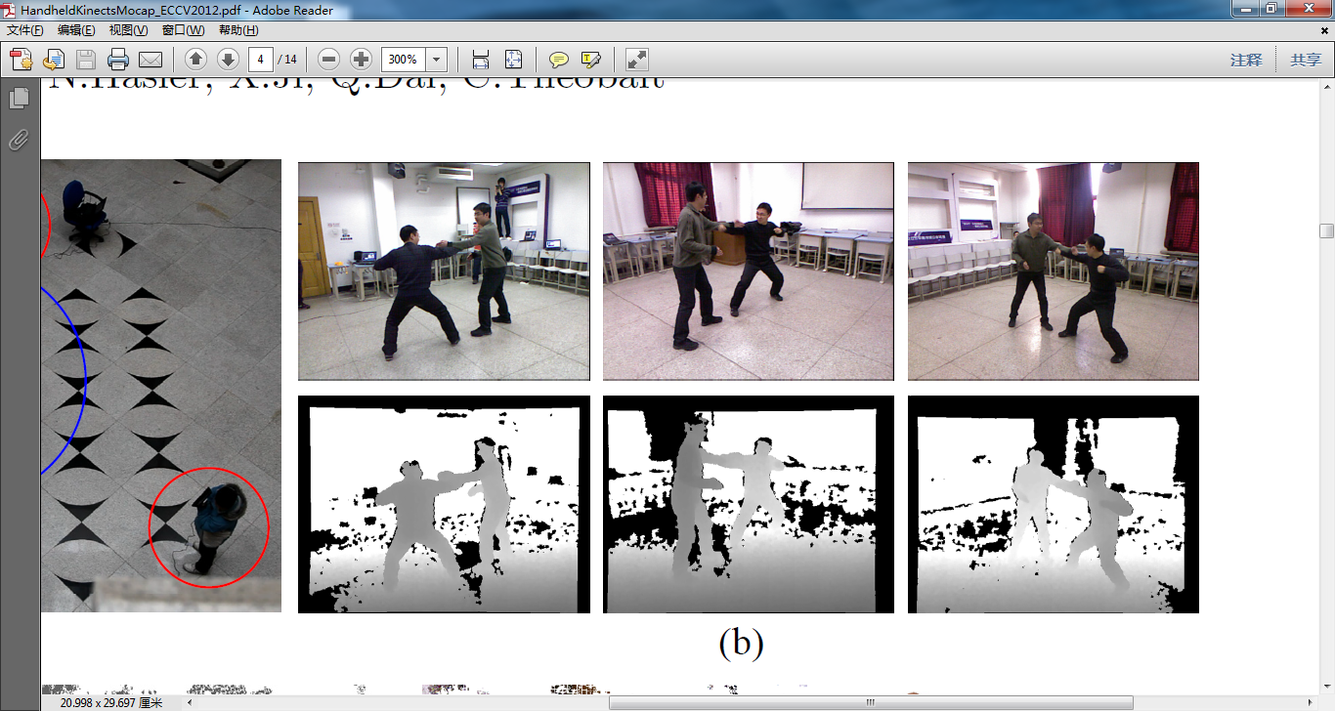
Our method
Estimate skeleton and surface deformation of interacting characters
Jointly optimization of human pose and camera extrinsic parameters
Can deal with fast and complex motion with frequent physical contact
Input:
Initial mesh and skeleton model
Multi-view depth and RGB images

Slide 6
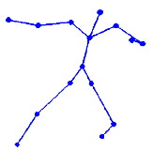

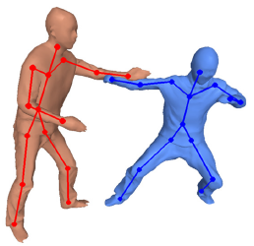
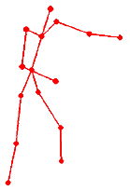
Algorithm overview
Point cloud space
Model space
Depth frame
Rigid transformation
Point cloud
Mesh vertex
Linear blend skinning
Mesh from last frame
Kinect extrinsic
Λ₁
Pose configuration
χ₁
Kinect extrinsic
Λ₂
Optimize
Pose configuration
χ₂
Kinect extrinsic
Λ₃
Parameters to be solved

Slide 7
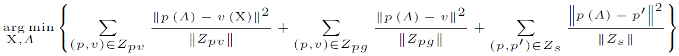
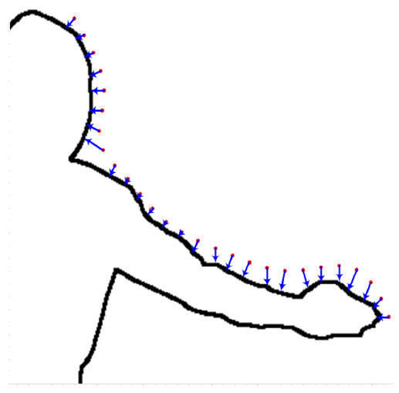
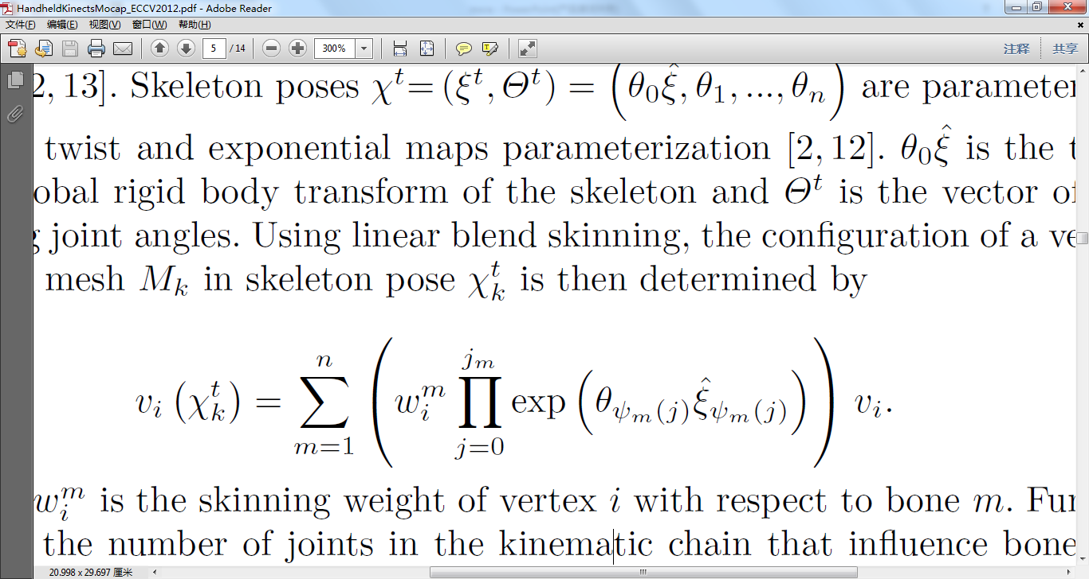
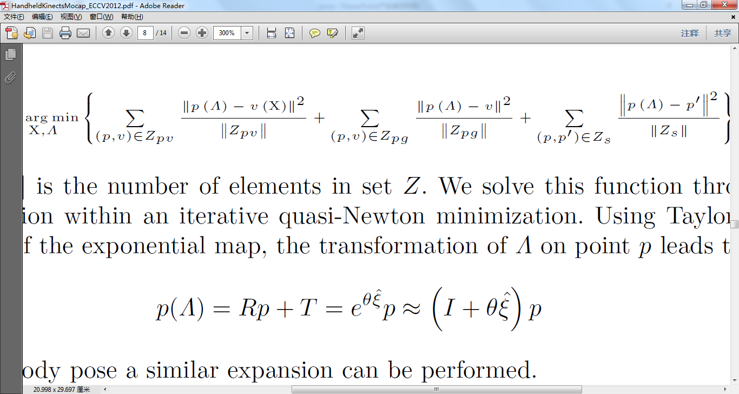
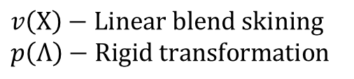

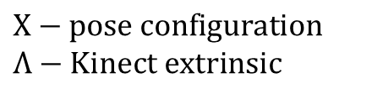
Joint Optimization
$$Χ−pose configuration$$
$$Λ−Kinect extrinsic$$
$$v\left(Χ\right)−Linear blend skining$$
$$p\left(Λ\right)−Rigid transformation$$
Joint motion capture term
Minimize the distance between transformed Kinect point and deformed body vertex
Ground regular term
Register Kinect point with ground plane model
SIFT regular term
Register SIFT feature from current frame with those from previous frame
Linearization of $v\left(Χ\right)=p\left(Λ\right)$ using expontential map
Solved using least square
$$AX=b$$

Slide 8
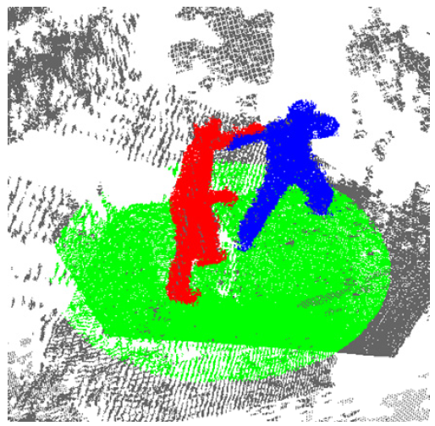
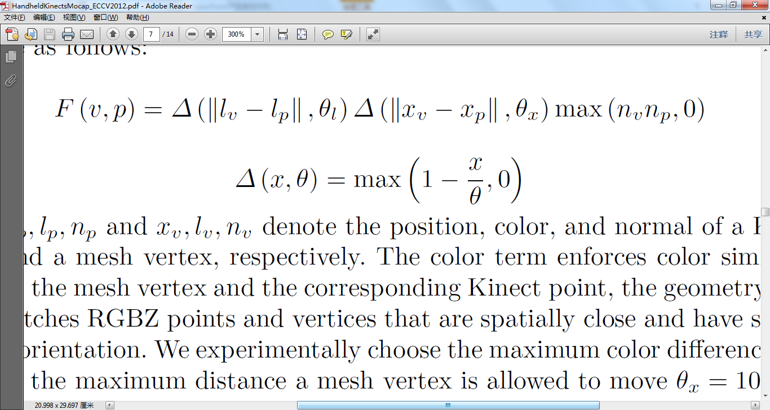
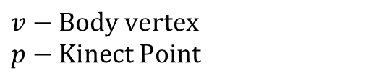


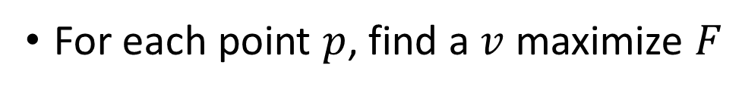
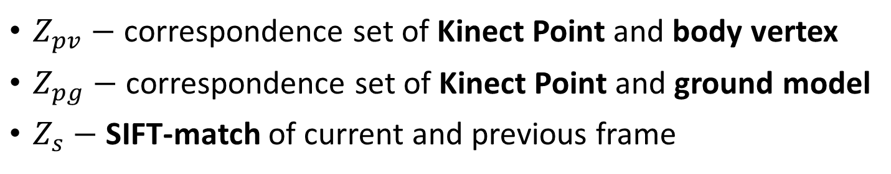


Correspondence finding
$$v−Body vertex$$
$$p−Kinect Point$$
$Z_{pv}−$ correspondence set of Kinect Point and body vertex
$Z_{pg}−$ correspondence set of Kinect Point and ground model
$Z_{s}−$ SIFT-match of current and previous frame
Iterate correspondence finding and joint optimization until converge
For each point $p$, find a $v$ maximize $F$
$$Δ$$
Color
distance
Normal
1
Classify $p$ according to label of $v$
$$θ$$
$$x$$

Slide 9
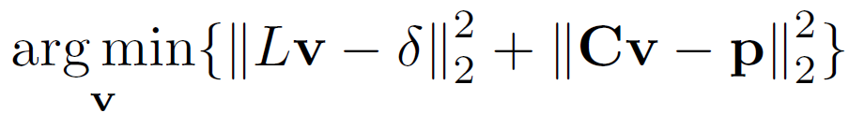
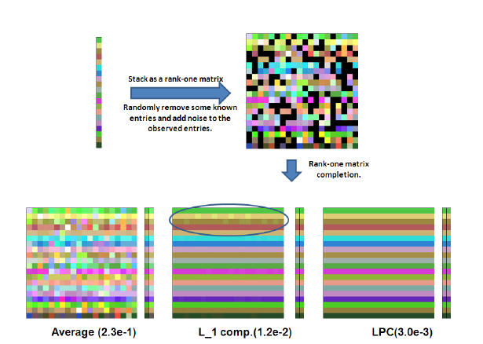

Mesh deformation and texture recovery
Texture recovery using matrix completion
Laplacian mesh deformation to simulate non-rigid cloth motion
True vertex color vector
Introduction of noise
Observed color matrix A
low rank learning
formulation
Recovered
color matrix A
time
time
vertex
vertex
$$\min{rank\left(A\right)+λ{\left\|N\right\|}_{l_{0}}}$$
Noisy matrix $N$ can be automatically learned after sparse optimization
vertex
  Kinect’s poor RGB quality
  RGB-depth mis-alignment
  Tracking/deformation error
  Missing data (black entry)
Intrinsic rank-1 matrix!!!
Temporal consistent
vertex color sequence

Slide 10
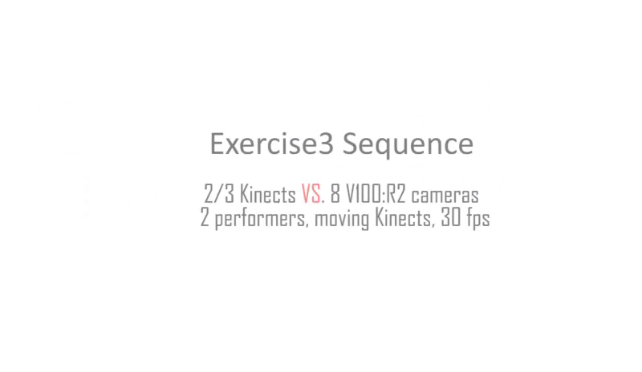
Quantitative evaluation
Comparison with commercial optical marker-based system

Slide 11
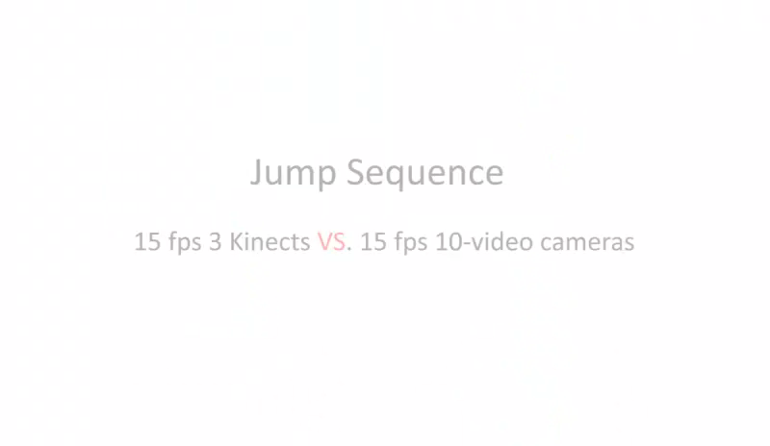
Quantitative evaluation
Comparison with multi-view video based system

Slide 12
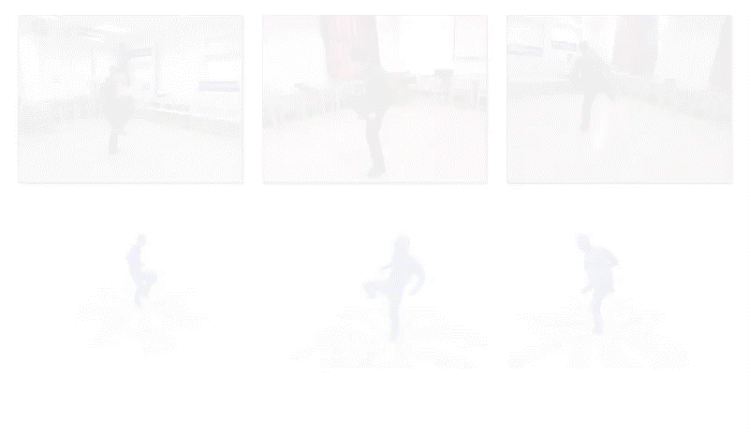
Results

