Slide 1
Capture
Close Interacting Motions
Yebin Liu
Tsinghua University, China
Notes:
Good afternoon. My talk is about capture close interacting motions. I am

Slide 2
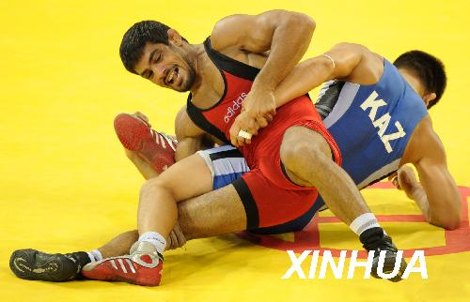
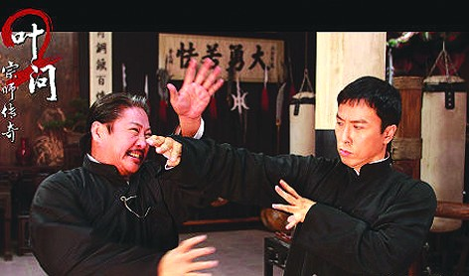
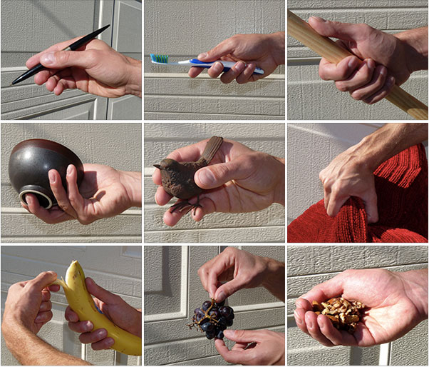
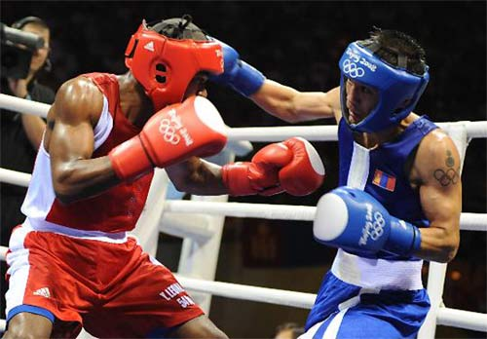
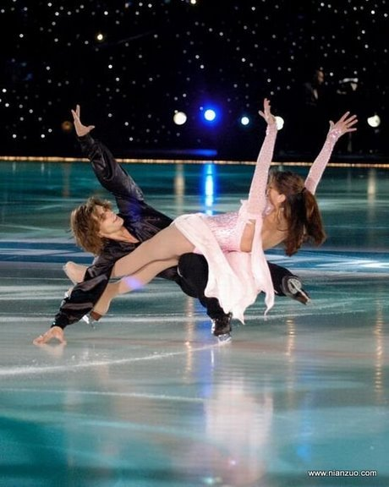
Close Interacting Motions
Body vs. body
Hand manipulate with objects
Challenges for 3D Reconstruction:
  Serious Occlusion
  Subtle Contact Phenomena
  Possible Collision
Important in : Animation, User Interaction, Sport analysis, Biomechanics, Ergonomics, Virtual reality, Robotics
Notes:
Close interacting motion is common in everyday life and there are important for graphics animation, user interaction, sport analysis, biomechanics and so on. The two typical cases are human body interacting with human body and hand interacting with object. Even for maker motion capture, it is challenging to have these motions, because of the serious occlusion, possible collision and the requirement for capture of subtle contact phenomena.

Slide 3
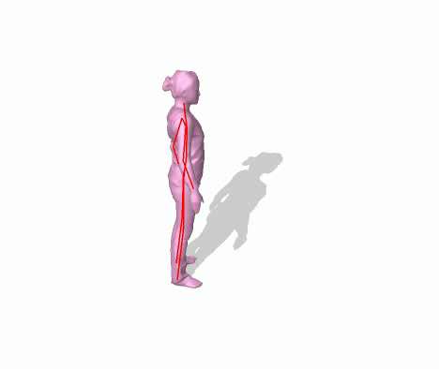
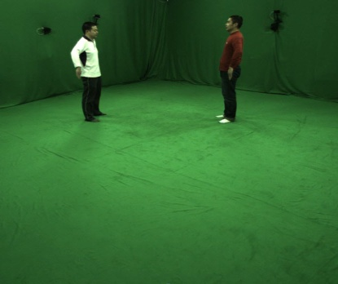
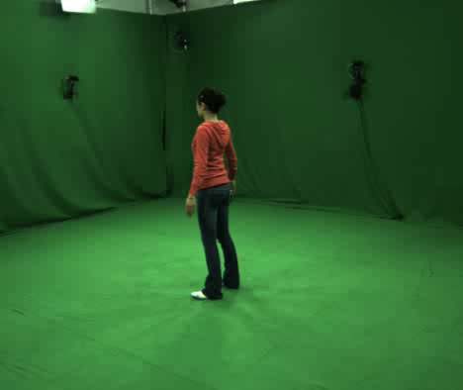
Problem Formulation: Single Target
Given the observed image I, search the optimal poses that best match I
Multi-view video data
Skeleton and Shape
“Analysis by synthesis” approach
Graphics for Vision
  Global optimization : Sampling Rendering Measurement
  Measure: silhouette term , feature term ,
How “Analysis by synthesis” approach can be improved for reconstruction of close interacting motions?
Notes:
We start the talk from traditional single character or single object motion capture. Given the observed image data, we usually try to search in the pose space \Xita, to find out the pose that minimize the difference between the observed images and the rendering result. With a sample in the pose space \Xita, we usually first skinning the pose to a 3D mesh and then possibly texture mapping on it to get the appearance. Such way is an analysis by synthesis approach with sampling then rendering and then measurement. In between, silhouette is the most important cues for motion tracking, sometimes SIFT feature will also considered. I will talk about how analysis by synthesis approach can be used in reconstruction of close interacting motions.

Slide 4
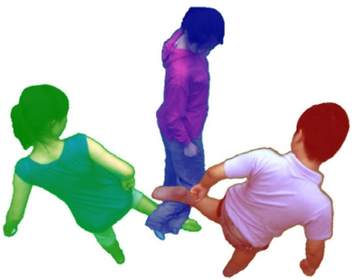
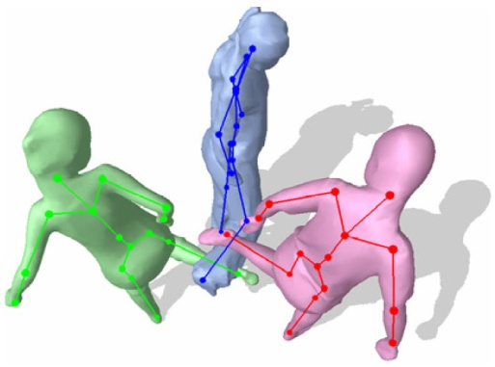
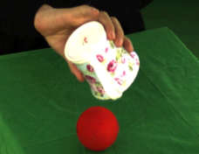
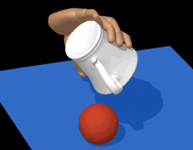
Outline
How “Analysis by synthesis (AbS)” methods can be improved for reconstruction of close interacting motions?
A
B
Multi-person motion capture (PAMI 2013)
Hand-object motion capture (SIGGRAPH 2013)
with Juergen Gall, Carsten Stoll, Qionghai Dai, Hans-Peter Seidel, Christian Theobalt
with Yangang Wang, Jianyuan Min, Jianjie Zhang, Feng Xu, Qionghai Dai, Jinxiang Chai
AbS for body labeling
AbS with physics constraint

Slide 5
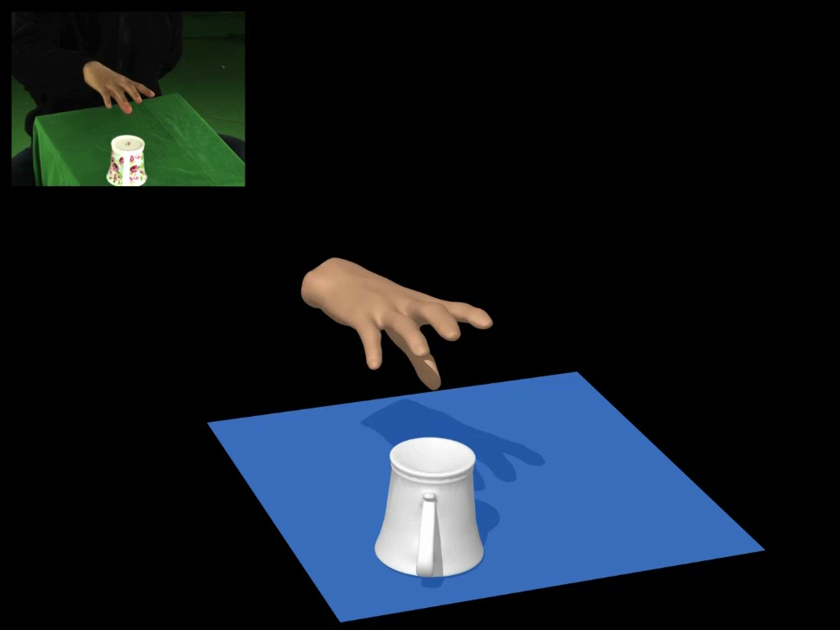
B. Hand-object Motion Capture
A video-based motion capture system for modeling physically realistic motion for hand manipulation
Notes:
We come to part B, hand-object motion capture. Our goal is to get this, a video based motion capture system for modeling physical realistic motion for hand manipulation.

Slide 6
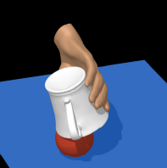
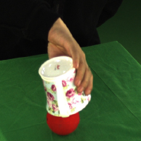
B. Hand-object Motion Capture
Challenges:
Requires modeling hand articulations, object movement, and subtle contact phenomena
- high dimensional (28 + 6)
- discontinuous (frequent contacts)
- coordinated movement and subtle interaction
Image measurement is often ambiguous
- lack of distinctive features
- non-diffuse surfaces
- significant occlusions
Notes:
This problem is also challenging because the lack of distinctive features on the hand, non-diffuse surfaces of the object and significant occlusions.

Slide 7
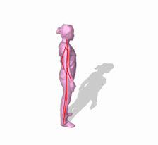
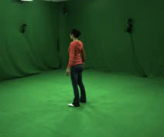
B. Hand-object Motion Capture
Idea: Integrate physics-based constraints to SbA
Skeleton and Shape
Multi-view video data
Parameterize the pose space to physics animation space
Simultaneously modeling hand articulations, object movement,
and subtle contact phenomena
Notes:
Our approach is to parameterize the pose space xita to physics animation space. Here we see that xita is changed to function Sim(M), a simulation function with parameter M. With this, we show that the reconstructed motion will be more plausible and we can model hand articulations, object movement and subtle contact.

Slide 8
B. Hand-object Motion Capture
Idea: Search an optimal motion control M to drive the simulation Sim(M) to best match the observed image data I
1
3
2
How to design a physics-based motion control M？
How to do sampling？
How to measure？
Notes:
The problem now is, we nee to search an optimal motion control M, to drive the simulation to best match the observed data. Using this would involves three questions. First, how to design a physics-based motion control M, second, how to measure the difference between input data and the rendered pose sample. Third, how to do sampling to find the optimal. I will introduce this three one by one.

Slide 9
B. Hand-object Motion Capture
Overview: Search target poses in the vicinity of video-based kinematic tracking poses
Image
measurements
Video-based
Kinematic Tracking
Kinematic motion
Image
measurements
Sampling-based
Control Optimization
Motion control
Simulated motion
Forward Simulation
(ODE)
Notes:
Before I introduce this three, I will first give you an overview of the whole algorithm. The central part is the green box here, sampling-based control optimization. This used the new measurement we described in the former slide. However, only using this tracking method can not solve the problem, because the motion control space is extremely huge for the optimization, so we need to first rely on the traditional video based motion tracking, to get the approximate poses. Here you can see we use the same image measurement in these two tracking parts.

Slide 10
B. Hand-object Motion Capture
Idea: Search an optimal motion control M to drive the simulation Sim(M) to best match the observed image data I
1
3
2
How to design a physics-based motion control M？
How to do sampling？
How to measure？
Notes:
So first, I will briefly describe how to design the motion capture for the hand and object frist.

Slide 11
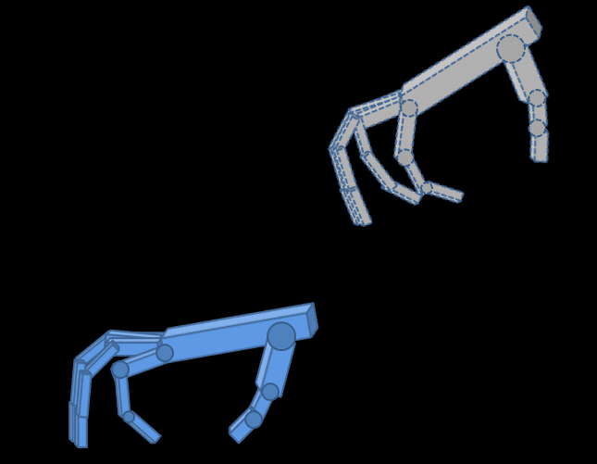
B. Hand-object Motion Capture
Physics-based Motion Control: Apply PD-servos (proportional Derivative) to model hand motion control
PD-servos
Active joint torques
Proportional term
Derivative term
Target hand pose
Search a sequence of target poses to advance the simulation to best match the observed data
Current hand pose
Notes:
Traditional way to model physics-based motion control is to use PD servos to compute internal joint torques for the hand. The PD servos consist of two terms: the proportional term pulls the current pose towards a target pose. The derivative term describes the current velocity. Q is the current hand pose and the q bar h is the target hand pose, We need to compute the active joint torques to simulate the motion.

Slide 12
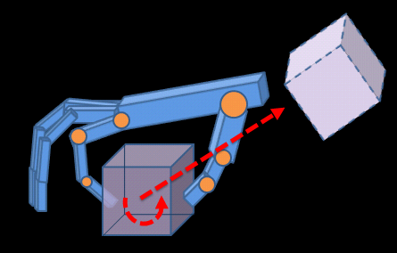


B. Hand-object Motion Capture
Composite Motion Control: Simultaneously model the movement of the hand, object and subtle contact phenomena
PD
Active joint torques:
Track hand articulations
Augmented joint torques: Track object movement
Notes:
However, PD-servo ignores the movement of the object. So we introduce composite motion control to simultaneously model the movement of the hand , object and the contact. The active joint torques are based on PD-servos, which track the trajectory of the hand. And the augmented joint torques track the object movement.

Slide 13
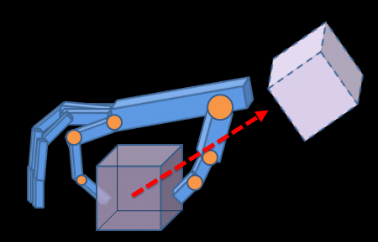
B. Hand-object Motion Capture
Virtual forces: the force needed to drive the object to reach the target position
The object is passive -- we must produce contact forces to realize the virtual forces!
Notes:
We first compute the virtual forces to make the object move to the desired position, calculate as the following equation. This virtual force is obtained from the hand, so we need to separate it to get the contact forces of the hand.

Slide 14
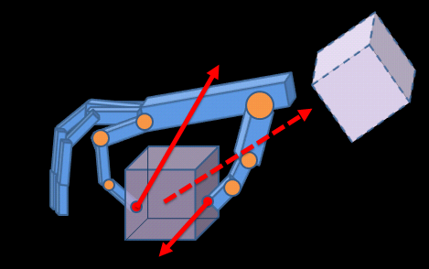
B. Hand-object Motion Capture
Contact forces: match the virtual forces to drive the object to the target position
Initial contact forces without virtual forces
Match the virtual forces
Minimal deviation from initial contact forces
Notes:
We model the contact torques as torsional torques. This allows us to approximately model soft-body contact between the hand and object.
Visualize torsional torques

Slide 15
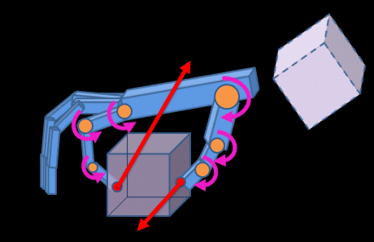
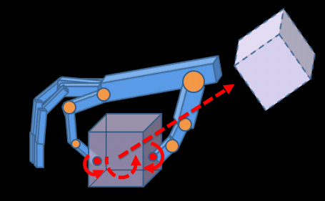
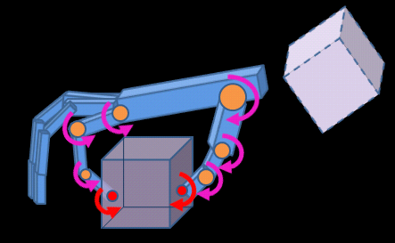
B. Hand-object Motion Capture
Augmented joint torques:
Position:
Compute virtual forces
Compute contact forces
Compute augmented joint torques
Orientation:
Compute virtual torques
Compute contact torques
Compute augmented joint torques
Notes:
We just describe how to compute an appropriate contact force to achieve the virtual forces. Similarly, we can compute appropriate contact torques to rotate the object to the target orientation.

Slide 16
B. Hand-object Motion Capture
Augmented joint torques: Apply the Jacobian transpose to transform contact forces and torques to internal joint space
Transformed contact forces
Transformed contact torques

Slide 17
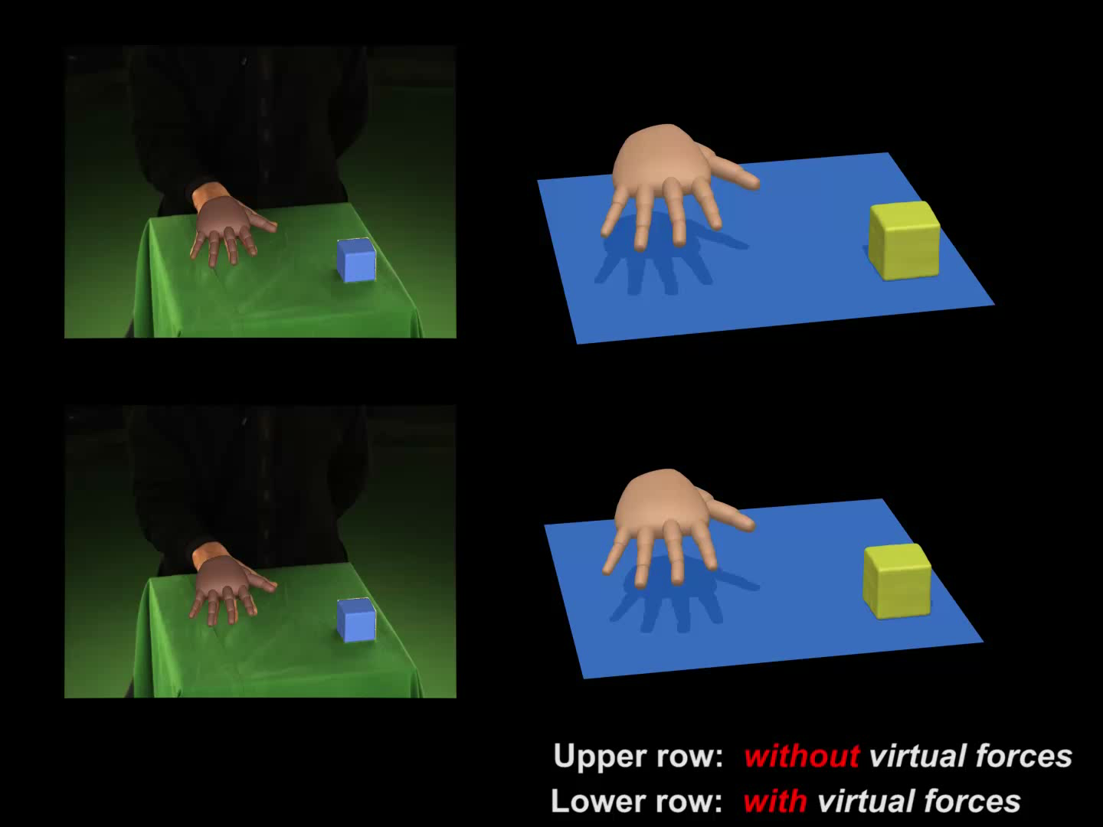
B. Hand-object Motion Capture
Evaluation: PD-servos vs. composite motion control
Notes:
This video shows the reconstruction results with/without contact forces.

Slide 18
B. Hand-object Motion Capture
Measurement: “Analysis by synthesis” strategy
How to measure?
silhouette term
color term
edge term
Interacting simulated annealing (ISA)
Notes:
We adopt an “analysis by synthesis” strategy to measure the difference between the two. The left figure shows the rendered image of the simulated pose. And the observed image is shown in the right side. Now we want to measure the difference between the rendered image and the observed image. How can we do that?
We define an objective function which consists of three terms. Here, the first term measures the inconsistency of sillhouette between the two images. The color term measures the color differences between the two images. The last term measures the edge inconsistency between the rendered image and observed image. I will talk about the detail of each term in the next several slides.

Slide 19
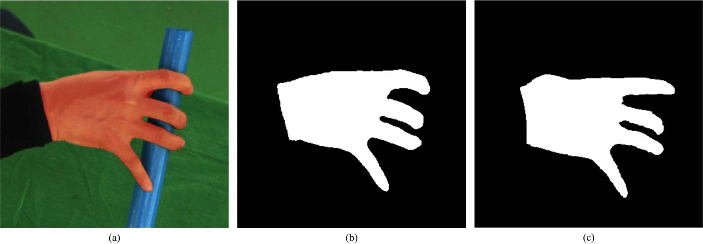
B. Hand-object Motion Capture
Measurement - Silhouette term:
Original image
extracted silhouette
rendered silhouette
[SGMMs, Palmer et al. 2006]
Notes:
Suppose the blue region is the rendered sil. And the orange region is the observed one. To measure the difference of two regions,

Slide 20

B. Hand-object Motion Capture
Measurement - Color term:
Original image
Observed hand
Rendered hand
Notes:
Now, let’s move to the color term. Again, the left is the original image, the middle and right show the observed color hand and rendered hand texture. To ensure our system is robust to nondiffuse surfaces and misalignment caused by approximate geometry and calibration errors, we define the following robust function to measure the color difference between the two images. Please refer to our paper for details.

Slide 21
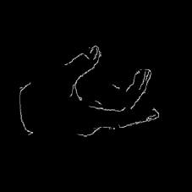
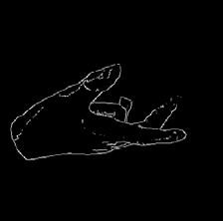
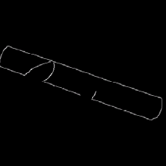
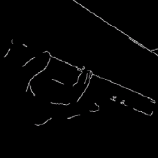
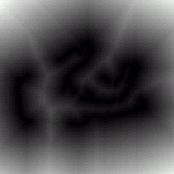
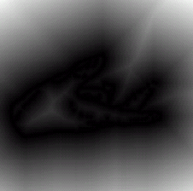
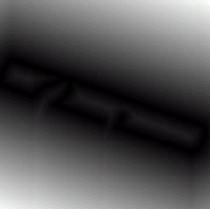


B. Hand-object Motion Capture
Measurement - Edge term:
Edge map
of original hand
Edge map
of rendered hand
Edge map
of rendered object
Edge map
of whole observed image
Edge distance transform
of original hand
Edge distance transform
of rendered hand
Edge distance transform
of rendered object
Edge distance transform
of whole observed image
edge of hand
edge of object
Notes:
Here is the details of our edge term. We apply distance transform to the binary edge maps and measure the inconsistency between two distance transformed images. The first term measures the differences of the hand, the second term shows the differences of the object.

Slide 22
B. Hand-object Motion Capture
Overview:
Image
measurements
Video-based
Kinematic Tracking
Kinematic motion
Image
measurements
Sampling-based
Control Optimization
Motion control
Simulated motion
Forward Simulation
(ODE)
Notes:
Here shows the framework of our algorithm. We now discuss how to do video-based kinematic motion tracking to initialize our sampling-based control optimization.

Slide 23
B. Hand-object Motion Capture
Sampling: Search target poses of the hand and object in the vicinity of reconstructed kinematic poses
Target pose
Next state
Kinematic motion
t
t + 1
Notes:
Here is our basic idea.
Suppose the blue curve represents the motion trajectory obtained from kinematic motion tracking.
At each time step, we search the target pose around the reconstructed pose at the next time step.

Slide 24
B. Hand-object Motion Capture
Sampling: Search target poses of the hand and object in the vicinity of reconstructed kinematic poses
Target pose samples
Current state
Kinematic motion
t
t + 1
Notes:
Here, the blue dots represent a number of sampled target poses.

Slide 25
B. Hand-object Motion Capture
Sampling: Simulating and get the control parameters
Simulation
Next state samples
Kinematic motion
t
t + 1
Notes:
We then simulate the motion using the torques obtained from each sample of target poses.

Slide 26
B. Hand-object Motion Capture
Sampling: Search target poses of the hand and object in the vicinity of reconstructed kinematic poses
t = t+1
Random Sampling
Dynamic Simulation
Calculating Cost
Selecting Samples
No
End?
t
t + 1
t + 2
t + 3
t + 4
t + 5
Yes
Notes:
We repeat the same process until we go through the whole motion sequence.

Slide 27
B. Hand-object Motion Capture
Sampling: Search target poses of the hand and object in the vicinity of reconstructed kinematic poses
t = t+1
Random Sampling
Dynamic Simulation
Calculating Cost
Selecting Samples
No
End?
t
t + 1
t + 2
t + 3
t + 4
t + 5
Yes
Notes:
We repeat the same process until we go through the whole motion sequence.

Slide 28
B. Hand-object Motion Capture
Sampling: Repeat
t = t+1
Random Sampling
Dynamic Simulation
Calculating Cost
Selecting Samples
No
End?
t
t + 1
t + 2
t + 3
t + 4
t + 5
Yes
Notes:
We repeat the same process until we go through the whole motion sequence.

Slide 29
B. Hand-object Motion Capture
Sampling: Repeat
t = t+1
Random Sampling
Dynamic Simulation
Calculating Cost
Selecting Samples
No
End?
t
t + 1
t + 2
t + 3
t + 4
t + 5
Yes
Notes:
We repeat the same process until we go through the whole motion sequence.
The diagram in the right side shows the outline of our sampling-based control optimization. After we do random sampling and dynamic simulation, we evaluate the cost of each trajectory using the objective function we described early on.

Slide 30
B. Hand-object Motion Capture
Sampling: Best sample corresponds to the lowest cost function value
t = t+1
Random Sampling
Dynamic Simulation
Calculating Cost
Selecting Samples
No
End?
t
t + 1
t + 2
t + 3
t + 4
t + 5
Yes
Notes:
The best sample corresponds to the lowest cost function value.

Slide 31
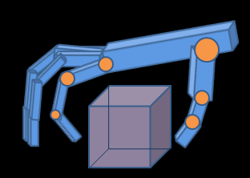
B. Hand-object Motion Capture
Random Sampling: Often produces many poor samples due to noisy contact information from kinematic tracking
No contact
A: failed manipulation
A
B: successful manipulation
B
Notes:
In practice, this idea does not work very well. This is because kinematic motion tracking results are often noisy and contain wrong contact information.
For example, in this particular pose, both thumb and index fingers should contact the cube. But due to tracking noise, both fingers did not contact the cube. Therefore, sampling around the reconstructed poses produces a lot of poor samples. Here all the samples in the region A are poor samples because they have wrong contact information

Slide 32
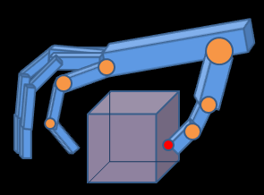
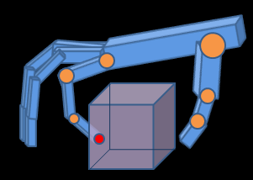
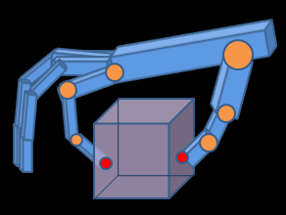
B. Hand-object Motion Capture
Contact based Sampling: Enumerate all the possible contact states within a particular error bound of tracking poses to produce seed points
No contact
A: failed manipulation
A
B
Index-finger
contact
Thumb & index
contact
B: successful manipulation
Notes:
Our idea is to assume a particular error bound for the tracking results. We enumerate all the possible contact configurations within this error bound.
For this particular example, there are three possible contact configurations. This allows us to produce three seed samples corresponding to each contact configuration,

Slide 33
B. Hand-object Motion Capture
Contact based Sampling: Randomly sample target poses around each seed point
No contact
A: failed manipulation
A
B
Index-finger
contact
Thumb & index
contact
B: successful manipulation
Notes:
we then randomly sample the target poses around each seed point. This strategy allows us to reduce the number of samples and thereby significantly speeds up the converge of our search process.

Slide 34
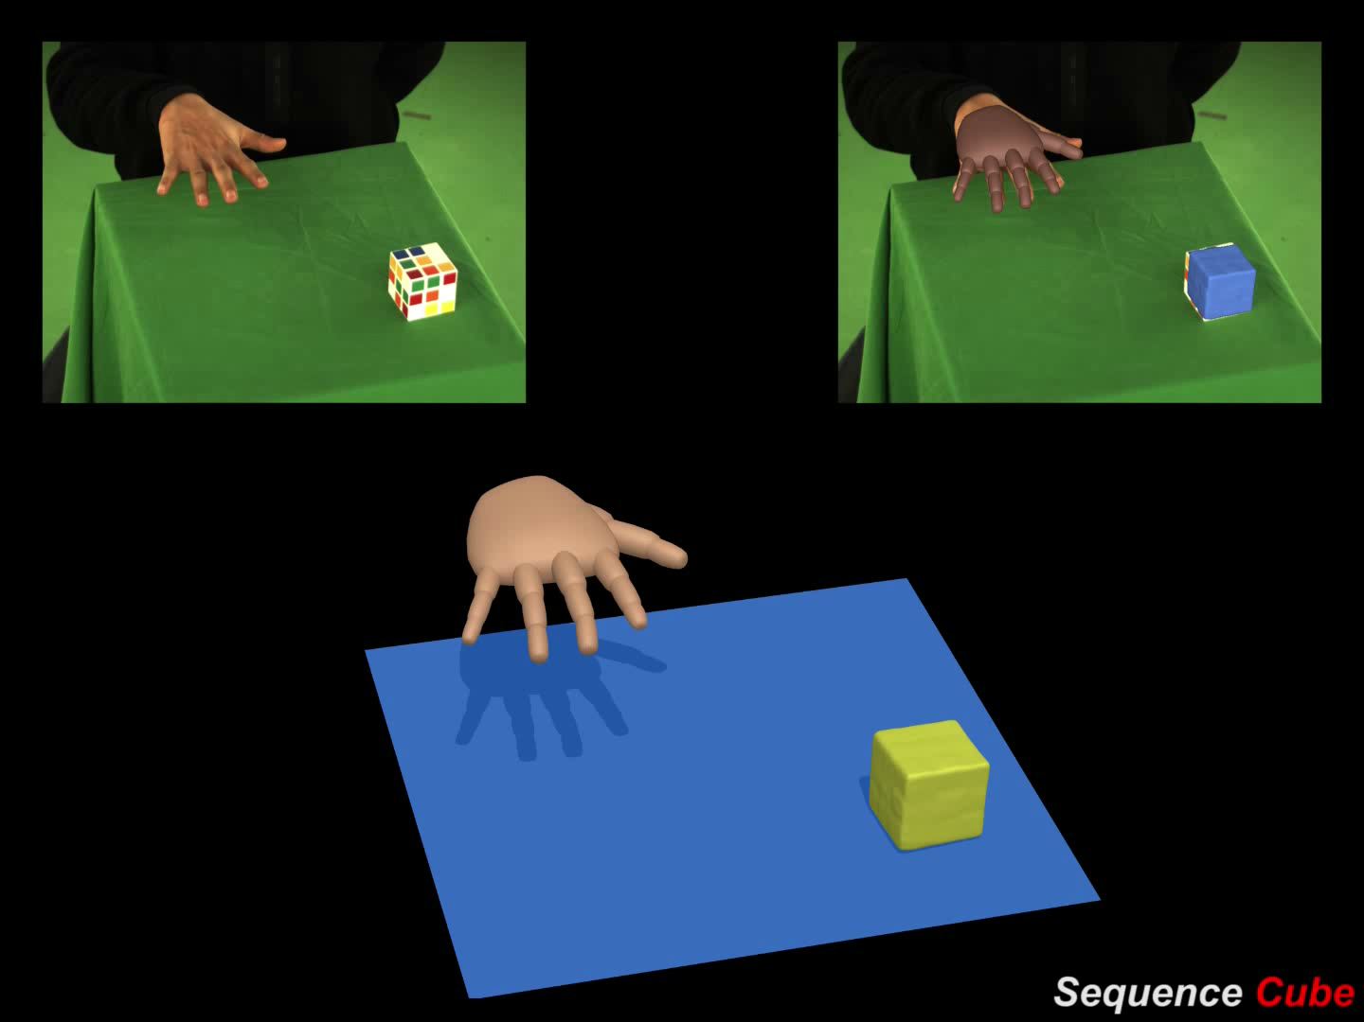
B. Hand-object Motion Capture
Results — Magic Cube:
Notes:
grasping a cube and continuously spinning it with fingers

Slide 35
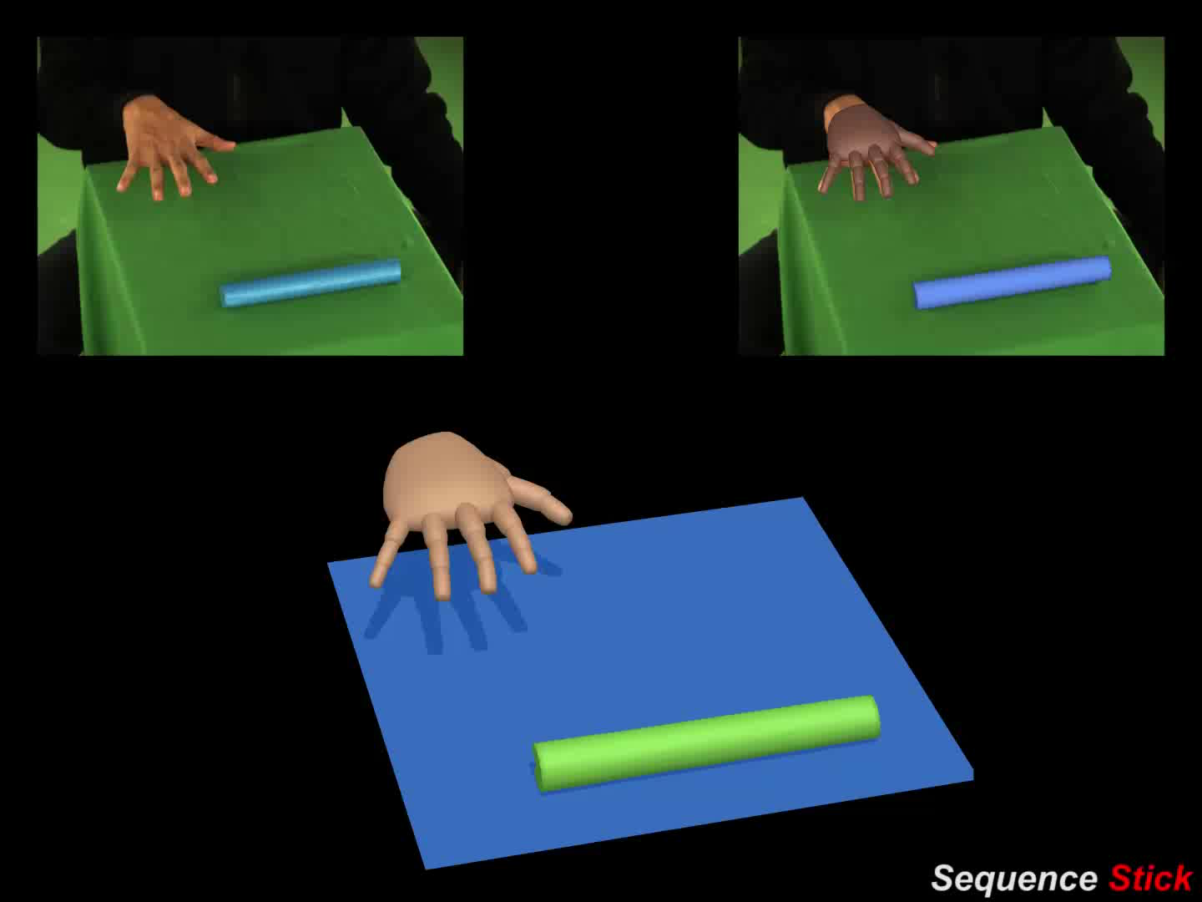
B. Hand-object Motion Capture
Results — Stick:
Notes:
Here is another example

Slide 36
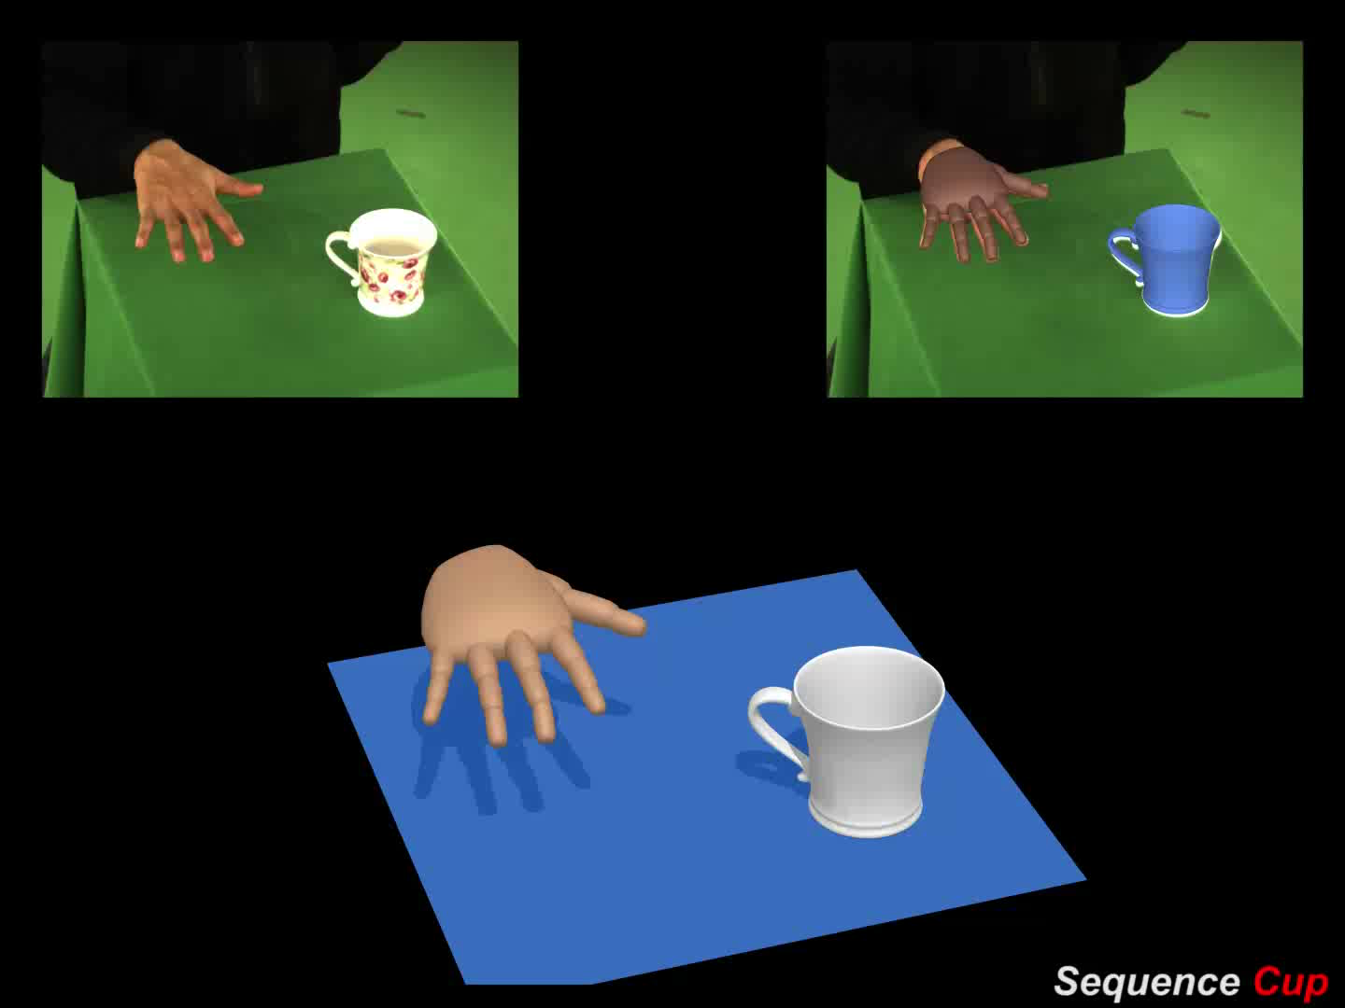
B. Hand-object Motion Capture
Results — Cup:
Notes:
Another result

Slide 37
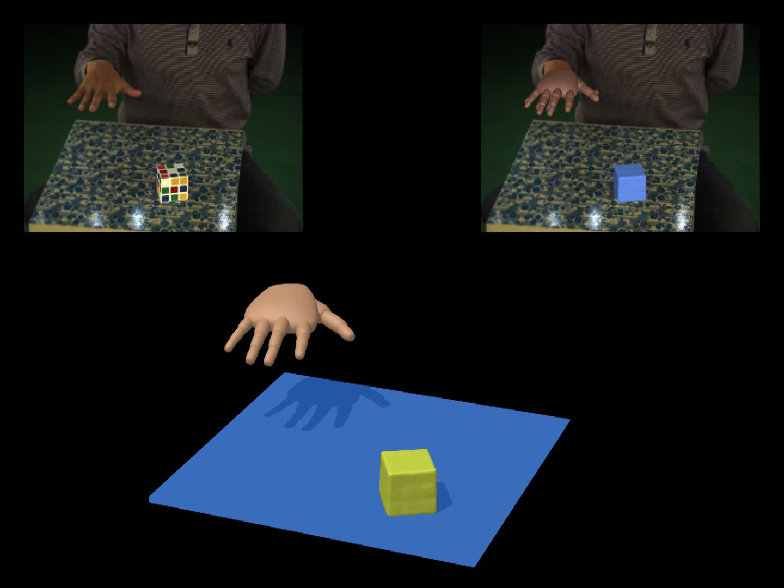
B. Hand-object Motion Capture
Results — Fast Motion & Complicated Background:
Notes:
this video shows we can acquire fast hand manipulation under a very complicated background

Slide 38
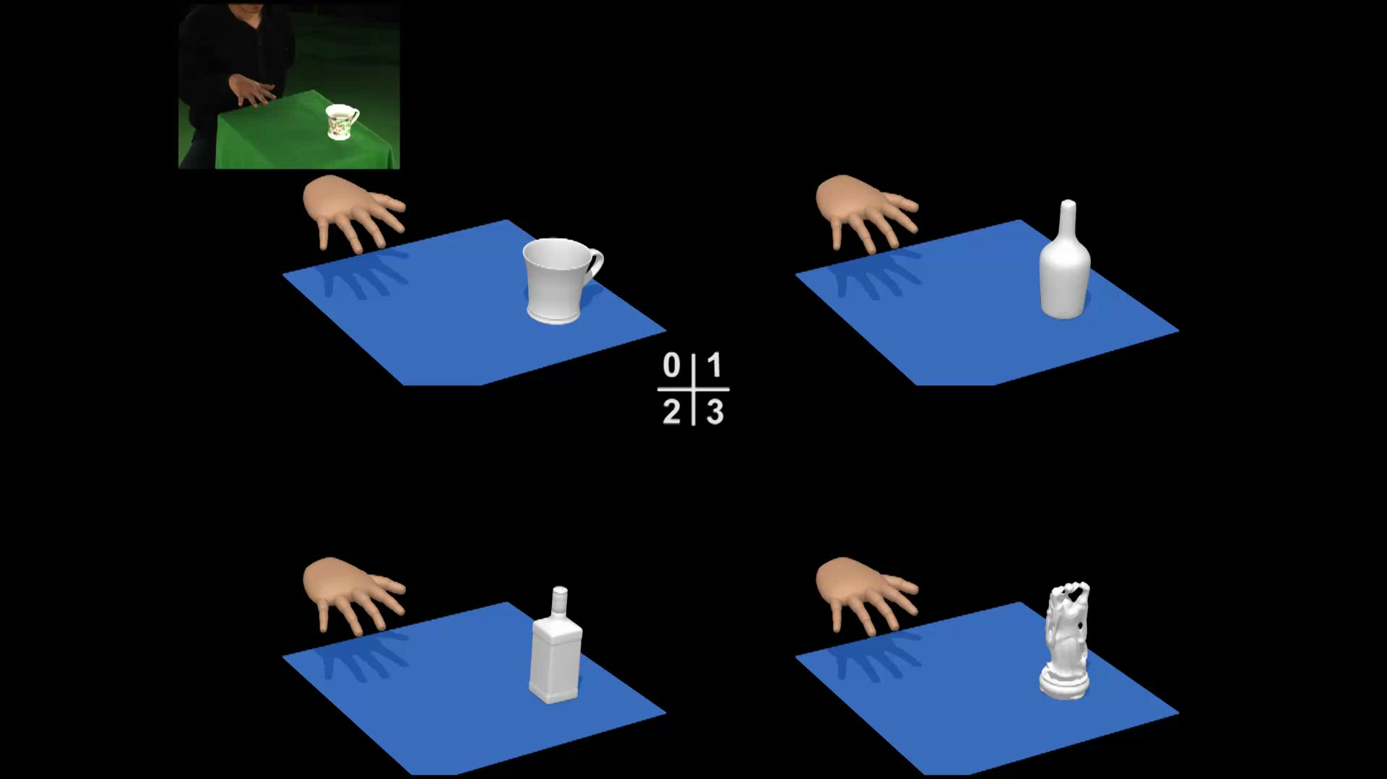
B. Hand-object Motion Capture
Results — Retargeting to New Objects:
Notes:
The video shows we can retarget the captured motion data to new objects with different geometry. Here is the example of cup

Slide 39
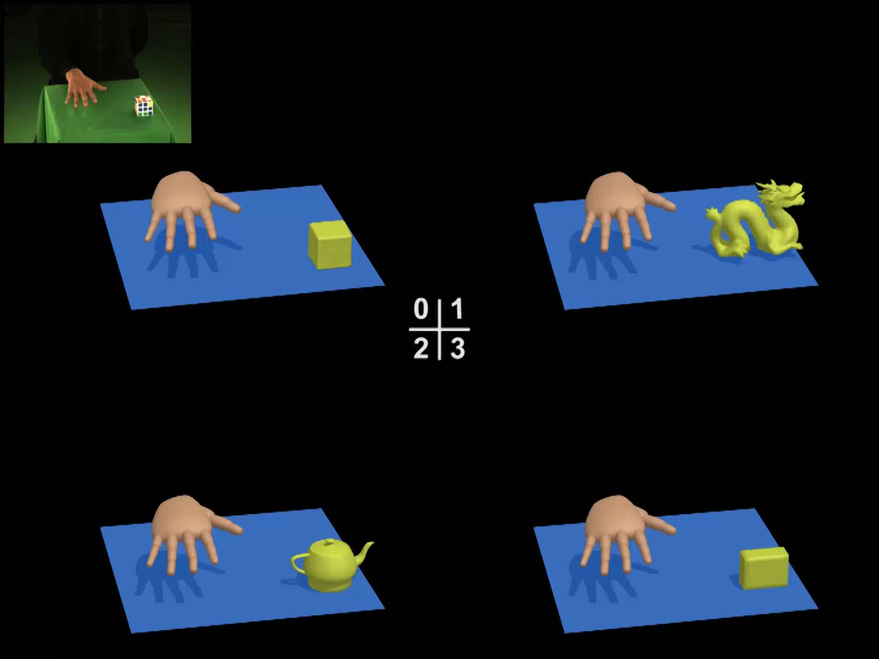
B. Hand-object Motion Capture
Results — Retargeting to New Objects:
Notes:
And here is the example of cube

Slide 40
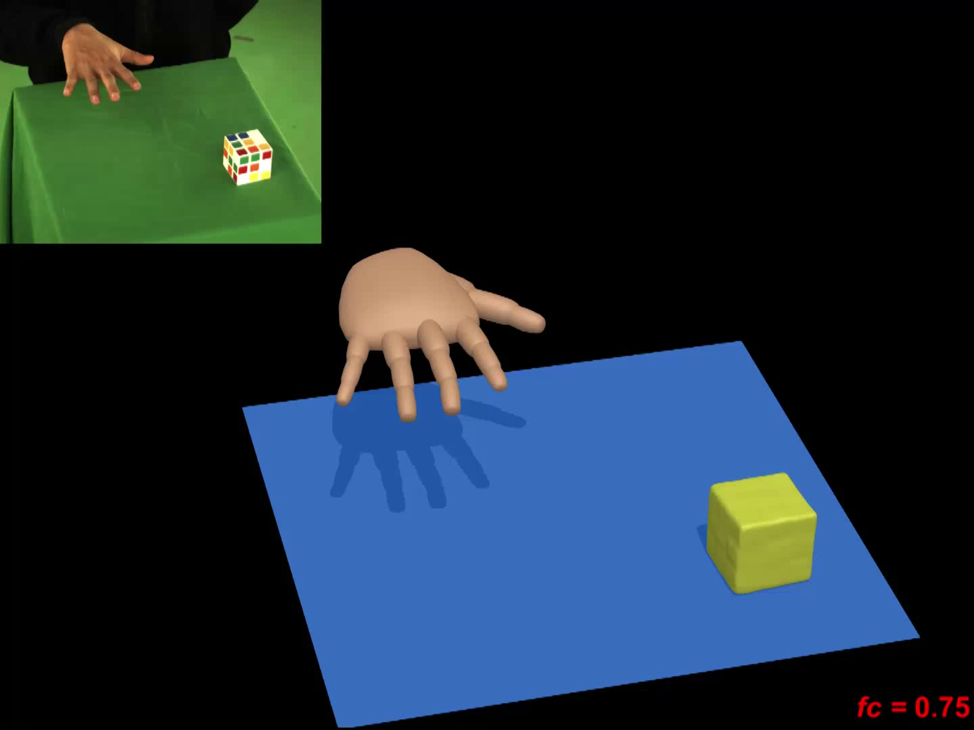
B. Hand-object Motion Capture
Results — Modifying the Friction Coefficients:
Notes:
Here is another result. The original motion capture data. We now change the frictions of the object.

